Slide 1
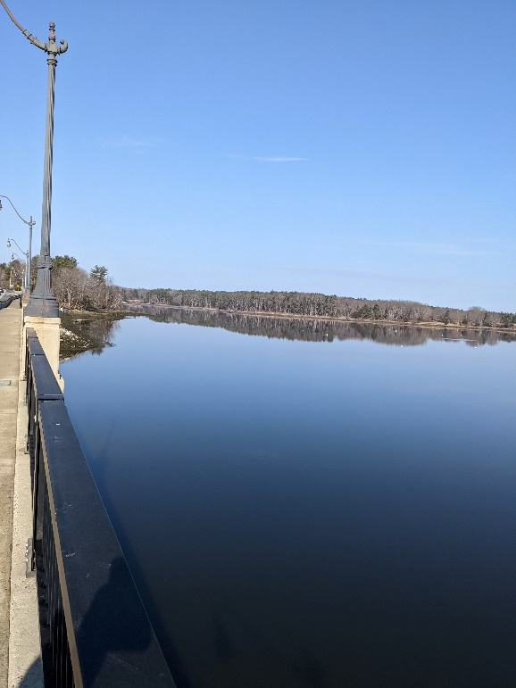

PRES 22
Full Scale Exercise
September 21, 2022
New Hampshire Department of Environmental Services
Spill Response & Complaint Investigation Section

Slide 2

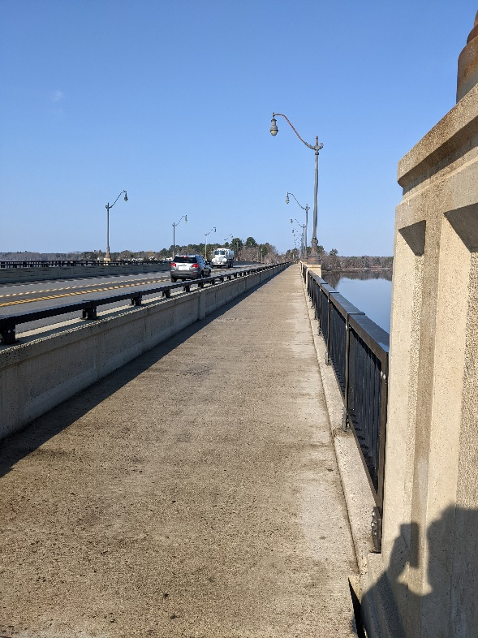
Exercise Plan
Smaller scale spill
12-13,000 Gallons
Tractor Trailer spill into the Bellamy River
Split between Incident Command Post and Field Activities
Test of field reporting App
Deployments linked to the exercise scenario
Reports coming to the command post from field participants
Possible Drone Overflight

Slide 3
Incident Command Post
  Full Activation
  limited JIC
  Early stages of response
  Test of new equipment
  Test of DES Virtual Incident Command Post
  Internal Communications
  External Communications to the field
  Taskings
  Virtual T Card Communication with Staging Area
  Common Operating Picture
  Inclusion of Remote Participants

Slide 4
Field Activities
2-3 GRSs
Skimmer
Rapid Assessment Teams
Simulated Oil

Slide 5
Field Activities
2-3 GRSs
Skimmer
Rapid Assessment Teams
Simulated Oil

Slide 6
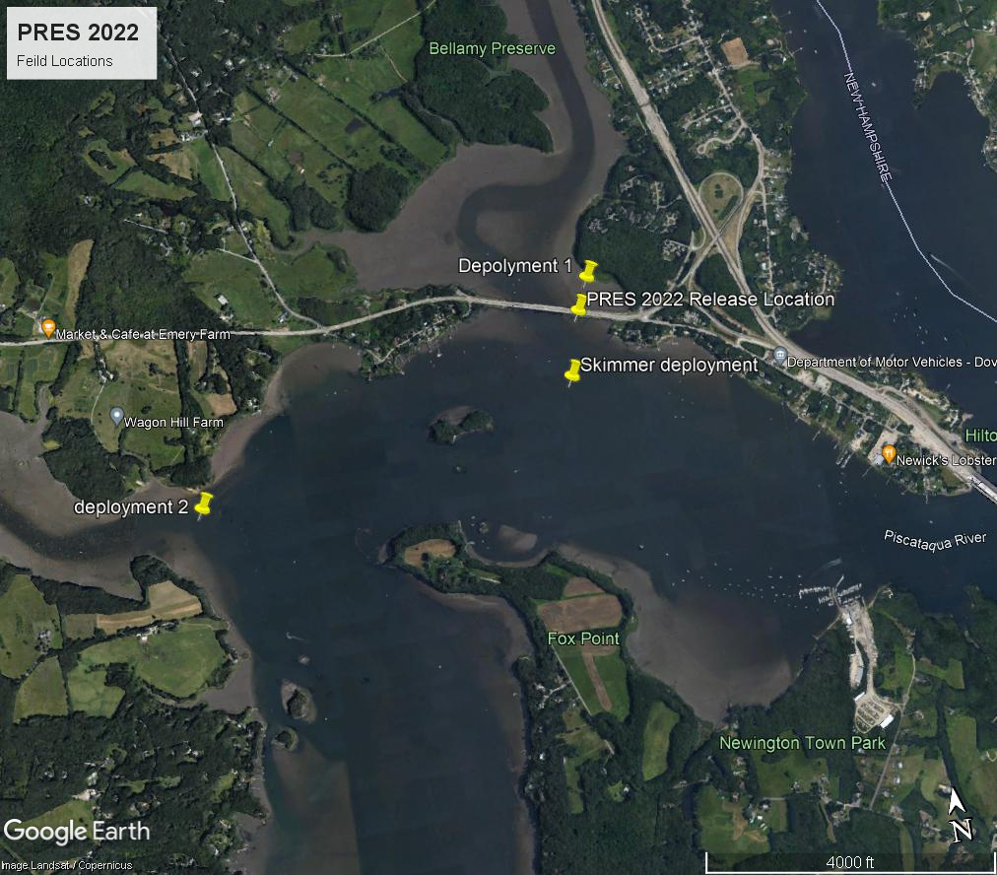
Exercise Field Locations

Slide 7
Questions?
  Jason Domke
  Planning and Preparedness Manager
  Spill Response & Complaint Investigation Section
  New Hampshire Department of Environmental Services
  222 International Drive
  Portsmouth, NH 03801
  O: (603) 559-1506
  C: (603) 724-0626
  Jason.Domke@des.nh.gov

