Slide 1
Reporting Information to DEP: Electronic Reporting
Troy Smith
Division of Technical Services
MAINE DEPARTMENT OF ENVIRONMENTAL PROTECTION
Protecting Maine’s Air, Land and Water

Slide 2
Two Required Items
PFAS Sampling Event Report, cover sheet with attachments, send to DEP electronically within 2 business days after event is complete
  Chain of Custody, separate one for each home
Results: EDD (Excel), Lab Report (PDF), Summary Table of Results.
  Send Results to DEP electronically within 5 business days of receiving the laboratory report. Project contact and edd.dep@maine.gov

Slide 3
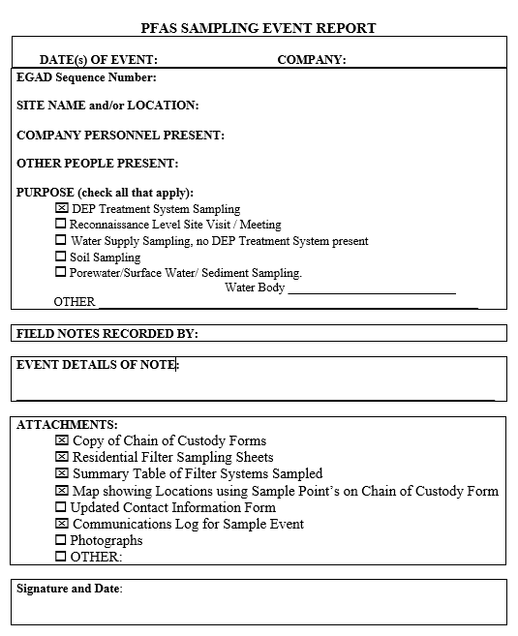
Event Details of Note: Bullet list: change of contact information, no response, information or questions from homeowner, or problems with or reported by the homeowner(s)

Slide 4
(1) PFAS Sampling Event Report
Cover Sheet with several attachments
  Separate CoC form for each homeowner
  Separate CoC for Duplicates and Field Blanks
  Residential filter sampling sheet for each system sampled
  Table of locations sampled, dates and times of sampling
  Map that shows sample locations using sample IDs on Chain of Custody
  Table of updated homeowner-tenant contact information
    Any changes in address, names, phone, etc.
  Contact communication log for contacting homeowners and tenants
    List of dates and times, email, voice mail, phone conversation, letters
    Two attempts to contact and a door knock, then email DEP contact and note on cover sheet

Slide 5
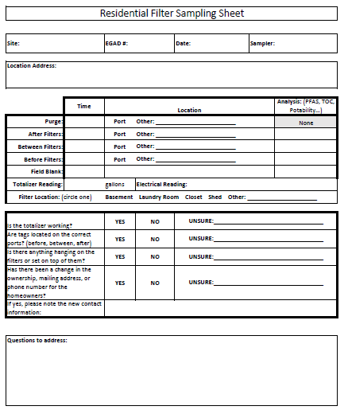

Slide 6
When DEP Requests Field Parameters
Field parameters for BE
  pH, Temperature, specific conductance (SpC)
  Record on bottom of Residential Filter Sampling Sheet, must be legible
  Calibration documentation for pH and SpC must be reported to DEP for the field event and include:
    Date, Time, Standard(s) used (i.e. for pH, 7 and 4 STU), and reading of the instrument after calibration
    If it is a multiple day event, then it must be calibrated daily (MEDEP uses Hanna Pocket Testers)

Slide 7
EDDs must be accurate and complete
The EDD must include:
  Correct EGAD Sequence Number
  Project Name
  Location Name
  Sample matrix/type
  Sample location
  Sample collection method
  Treatment status
  Field parameters for BE must be added to EDD

Slide 8
Chain of Custody
Contractors are encouraged to adopt an electronic Chain of Custody Form to help populate the EDD correctly
  MEDEP Alpha CoC is in Excel format is available for you to modify and use
May be able to arrange for laboratory to add information on CoC to the EDD

Slide 9
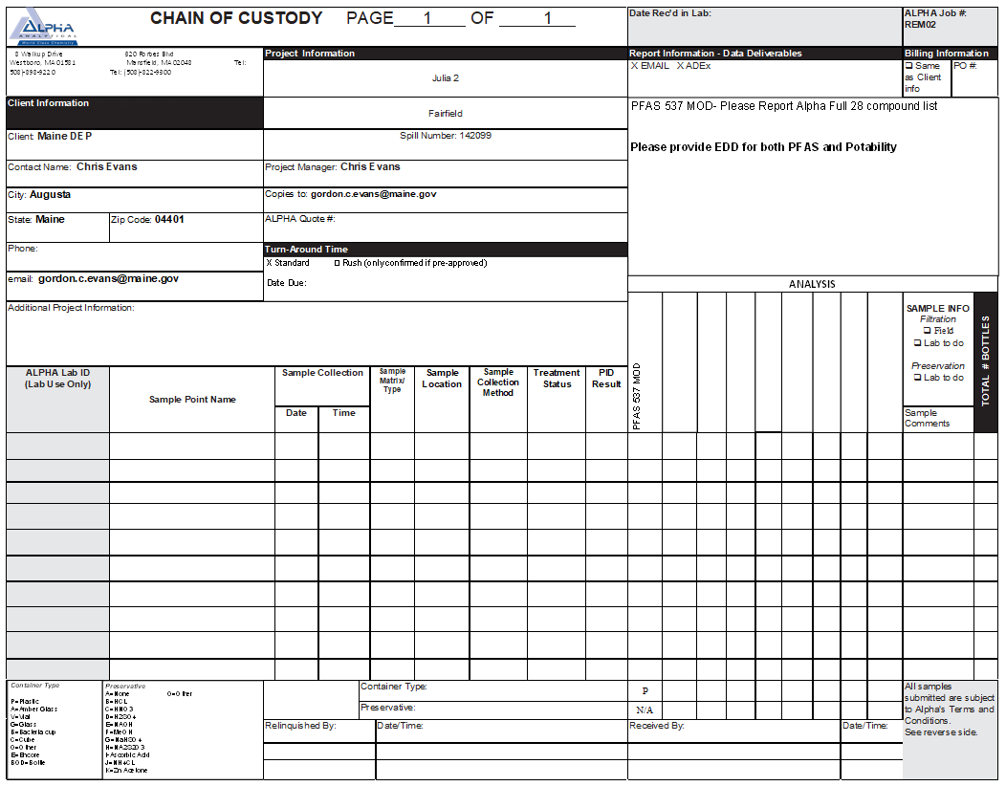
MEDEP CofC- front side

Slide 10
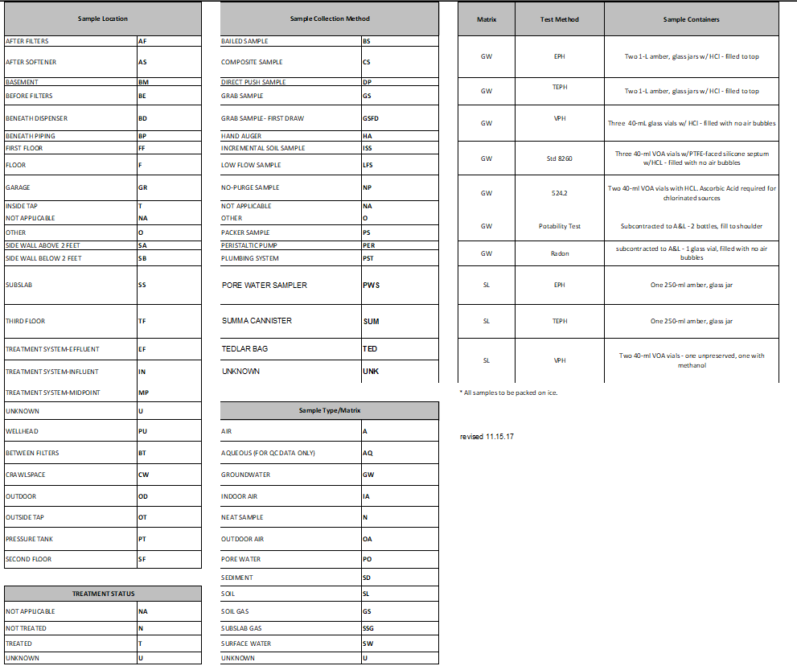
Chain of Custody- backside

Slide 11
Reporting: EDD Required Fields
Sample Matrix
  Groundwater (GW)
Sample Locations
  Before Filters (BE)
  Between Filters (BT)
  After Filters (AF)
  After Softener (AS)
Sample Collection Method
  Plumbing system (PST)

Slide 12
Reporting: EDD
Treatment Status
  BE, the status is Not Treated (N), unless there is treatment present before the GAC filter
  BT, the status is Treated (T)
  AF, the status is Treated (T)
Analysis
  PFAS 537 MOD-28 compound list
Lab Report
  Level II Report

Slide 13
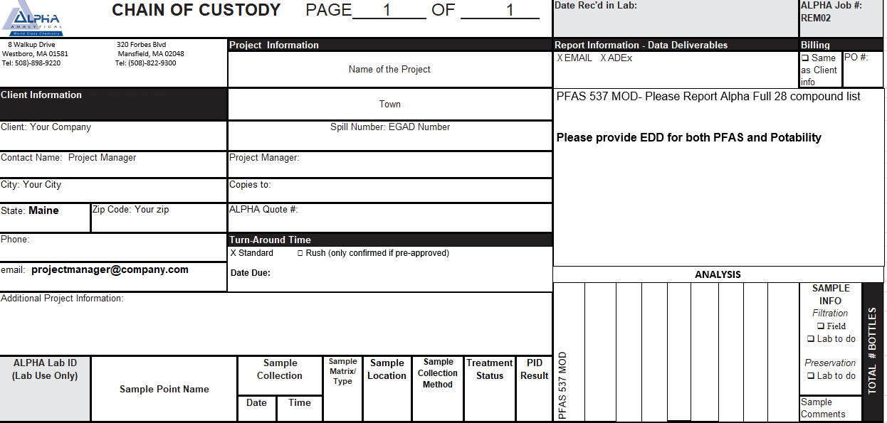
Top Section

Slide 14
Chain of Custody
Client: Your Company
Contact Name: Your Company PM
Email: Your Company PM
Project Information: DEP will assign name
Project Number: DEP will provide the EGAD Number, must be in the EDD
Standard Turn-Around Time

Slide 15
(2) Reporting Results to DEP
Individual laboratory reports for each well/system sampled (PDF)
Associated Electronic Data Deliverable for each laboratory report in accordance with DEP website: https://www.maine.gov/dep/maps-data/egad/#es
Summary table of PFAS sum of 6 detections in before filter (BE), midpoint (MP), and after filter (AF) (Format on Next Slide)

Slide 16
Summary Table Format
 |  |  | Sum of 6, in ng/L (ppt)
Address | Sample Date | Lab Report Number | Before Filters | Between Filters | After Filters
100 NYES CORNER DRIVE | 3/11/2021 | L2205893 | 5862 | 42.84 | 0 |  | Red- >20ppt
106 NYES CORNER DRIVE | 3/11/2021 | L2205894 | 5440 | 0.256 | 0 |  | Yellow- <20ppt, >0ppt
107 NYES CORNER DRIVE | 3/30/2021 | L2205895 | 37670 | 0 | 0 |  | Green- ND
13 HOWE ROAD | 3/11/2021 | L2205896 | 13000 | 0.266 | 0.015
15 BRETON HILL RD | 3/11/2021 | L2205897 | 1200 | 0.346 | 0
17 HOWE ROAD | 3/11/2021 | L2205898 | 963 | 0 | 0
25 HOWE ROAD | 3/11/2021 | L2205899 | 7631 | 94.49 | 5

Slide 17
Special DEP Requests
When/if DEP makes requests to conduct additional analyses (TOP Assay, TOC, Fe, etc.)
  Include on a separate Chain of Custody
  Explain in Trip Report
  Note in comments section of table

Slide 18
Recap: Two Items
PFAS Sampling Event Report, cover sheet with attachments, send to DEP electronically within 2 business days after event is complete
  Chain of Custody, separate one for each home
Results: EDD (Excel), Lab Report (PDF), Summary Table of Results.
  Send Results to DEP electronically within 5 business days of receiving the laboratory report. Project contact and edd.dep@maine.gov

Slide 19

Troy Smith
Hydrogeology Unit Manager
Troy.T.Smith@maine.gov

