Slide 1
Filter Sampling in Central Maine
Matt Burke
Senior Environmental Hydrogeologist
Maine DEP, Bureau of Remediation and Waste Management

Slide 2
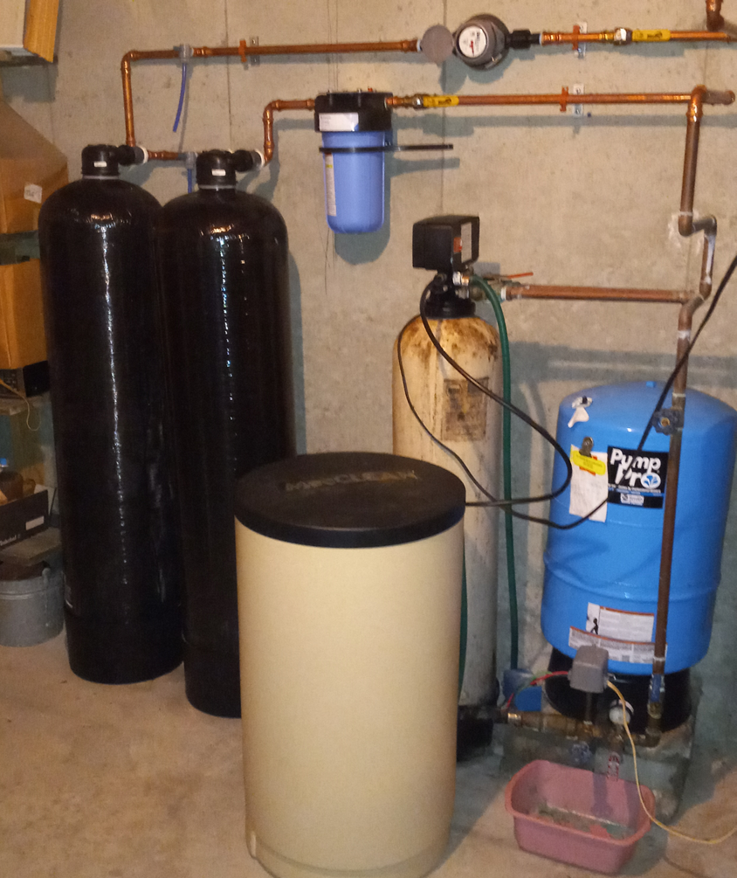
What’s there?
Two GAC filters
Totalizer
Before, between, and after ports
Maybe:
  Shed
  Water softener
  Big Blue or other
  Electrical meter

Slide 3
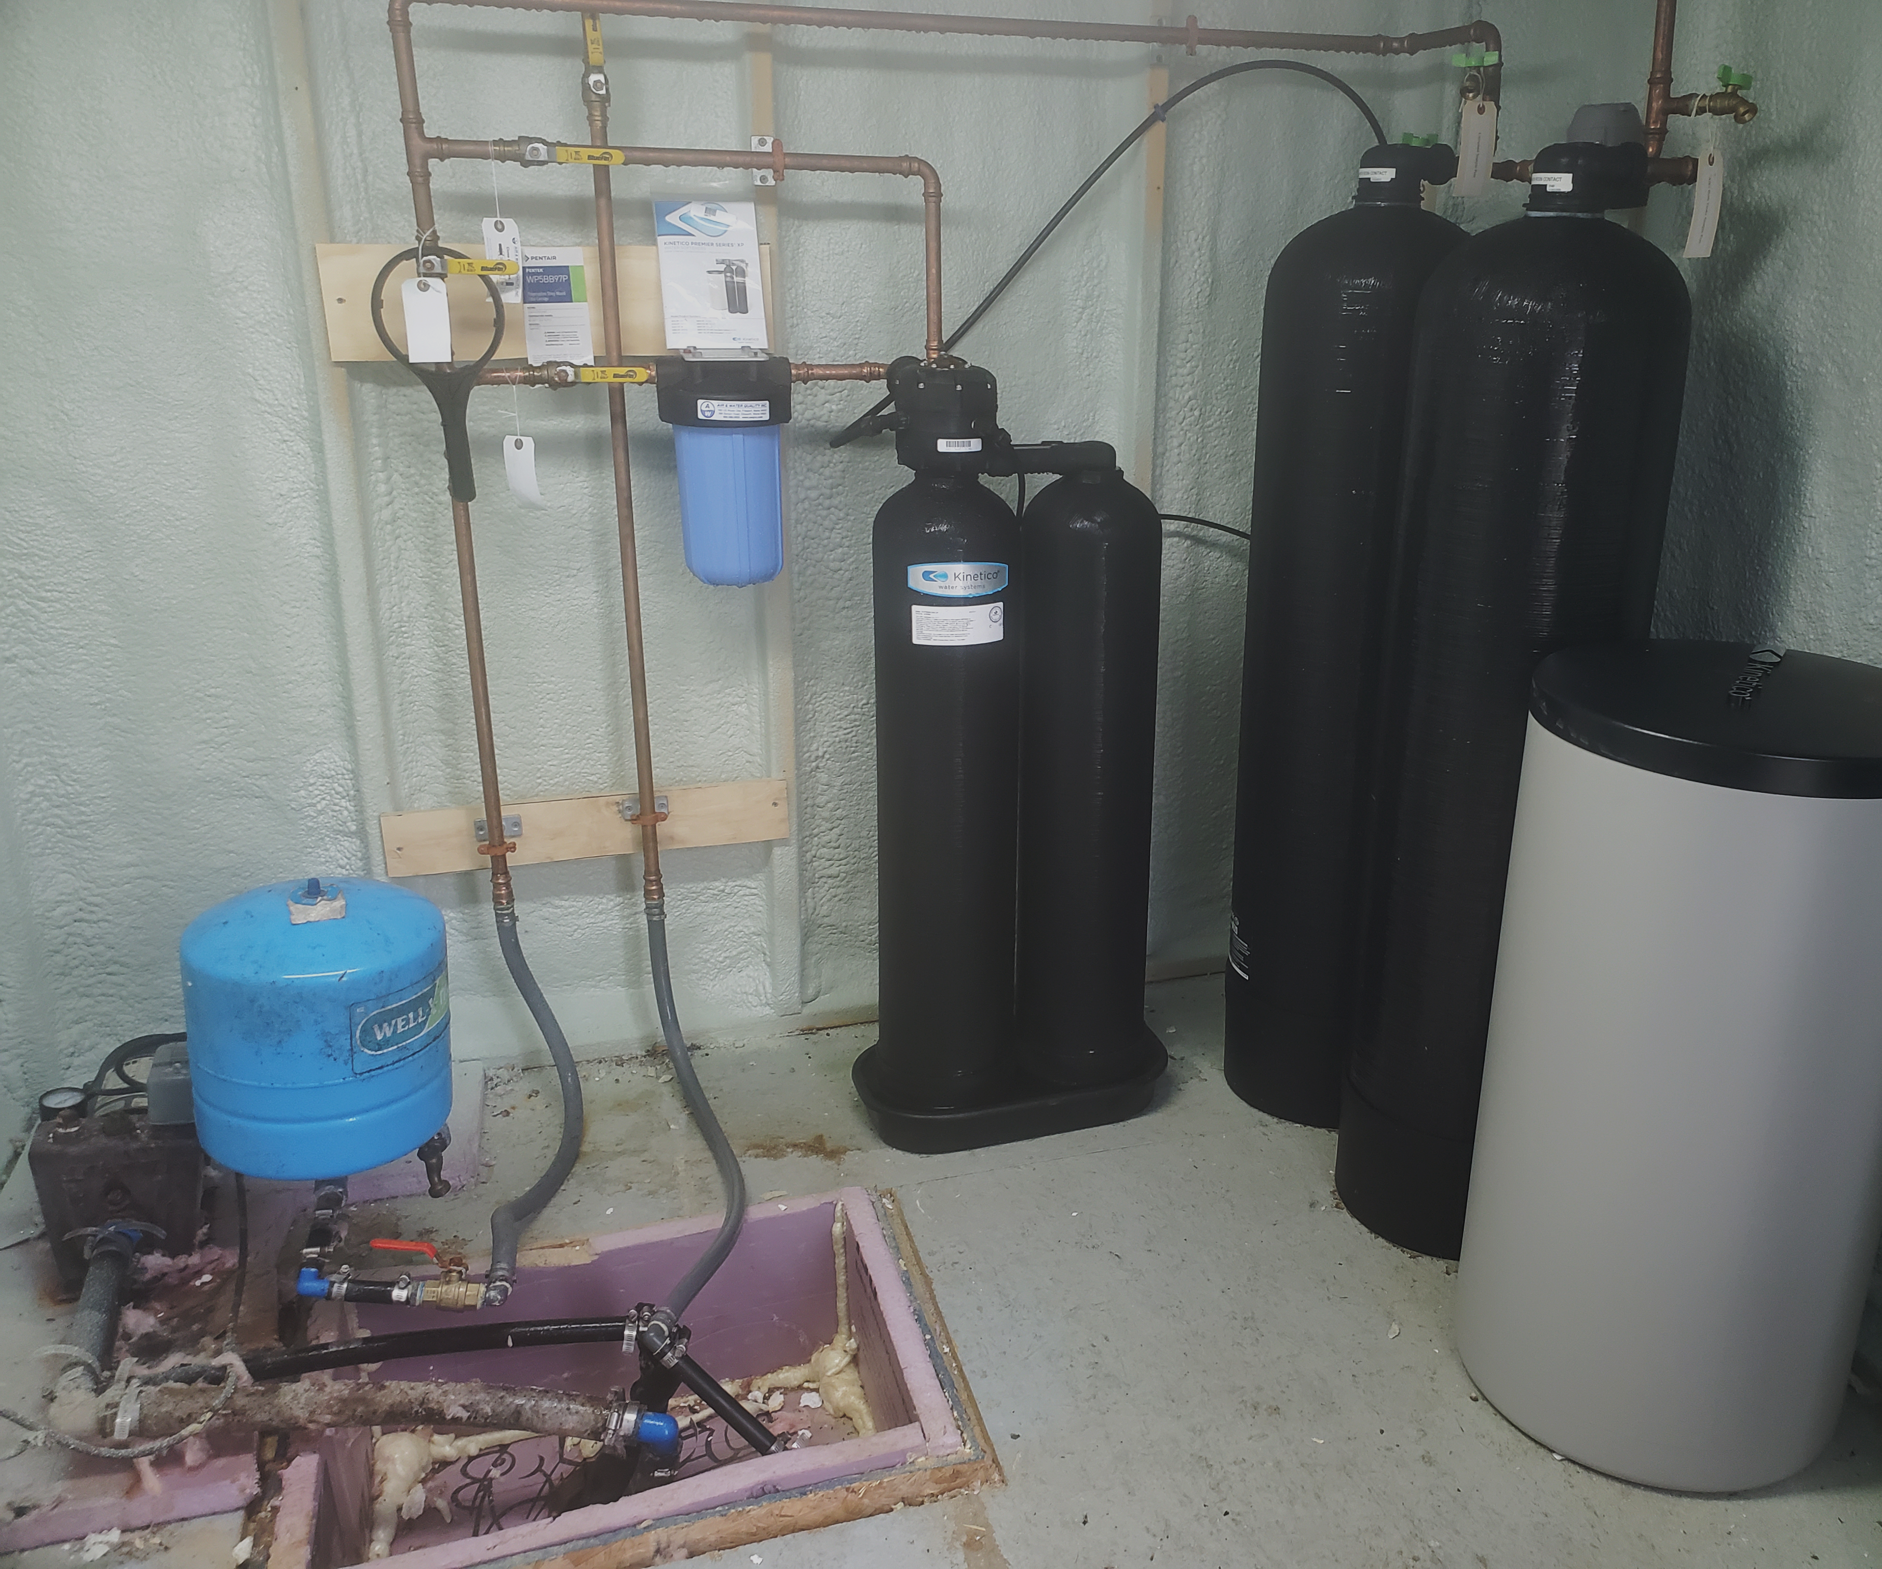
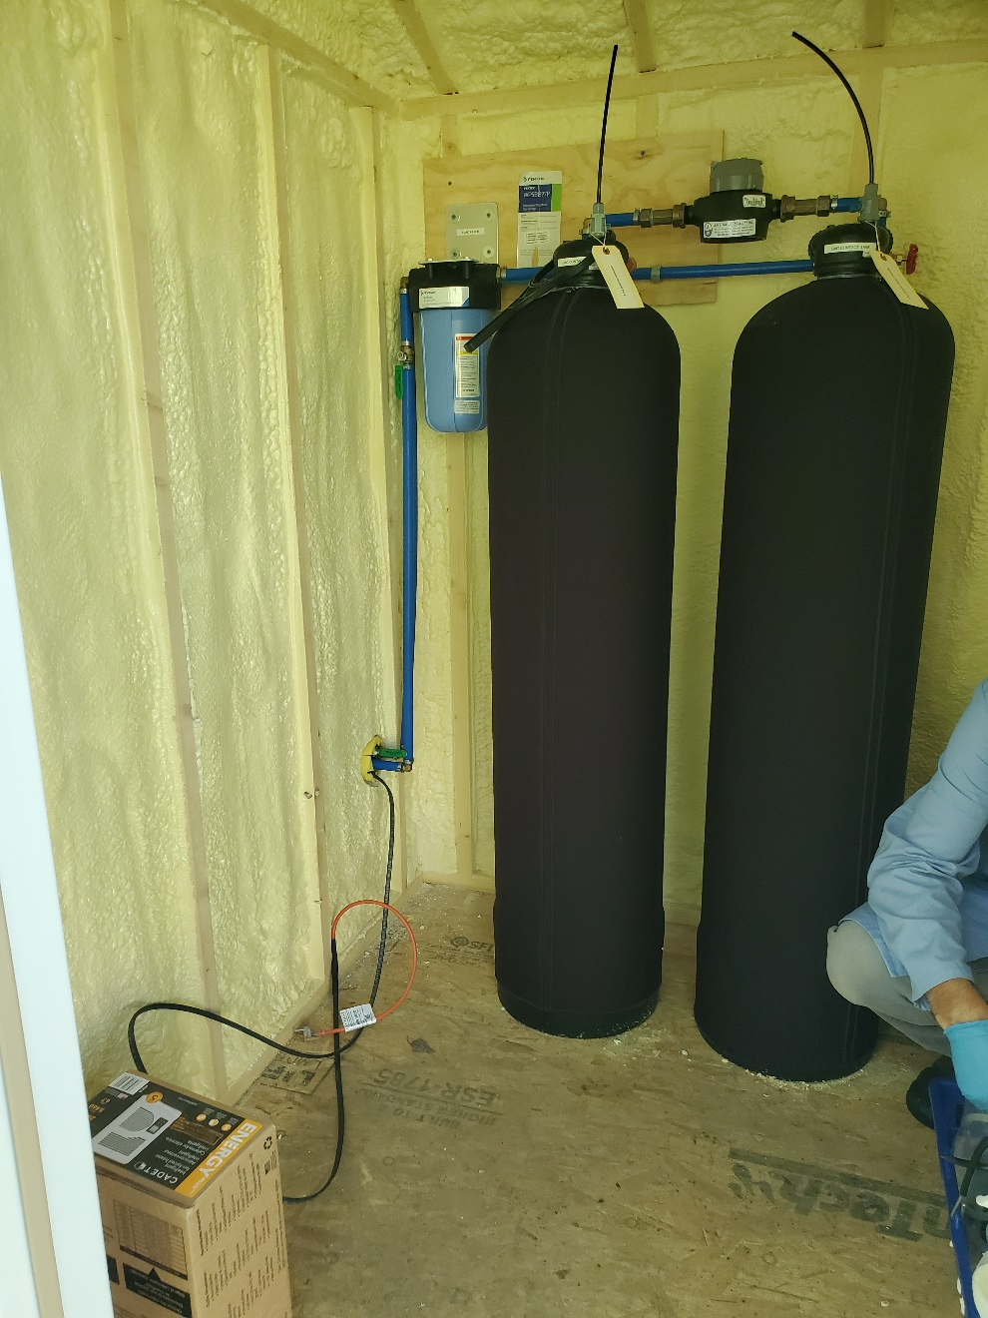
Notes:
Shed Systems

Slide 4
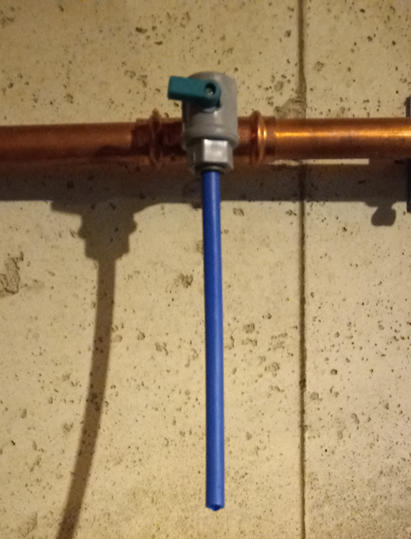
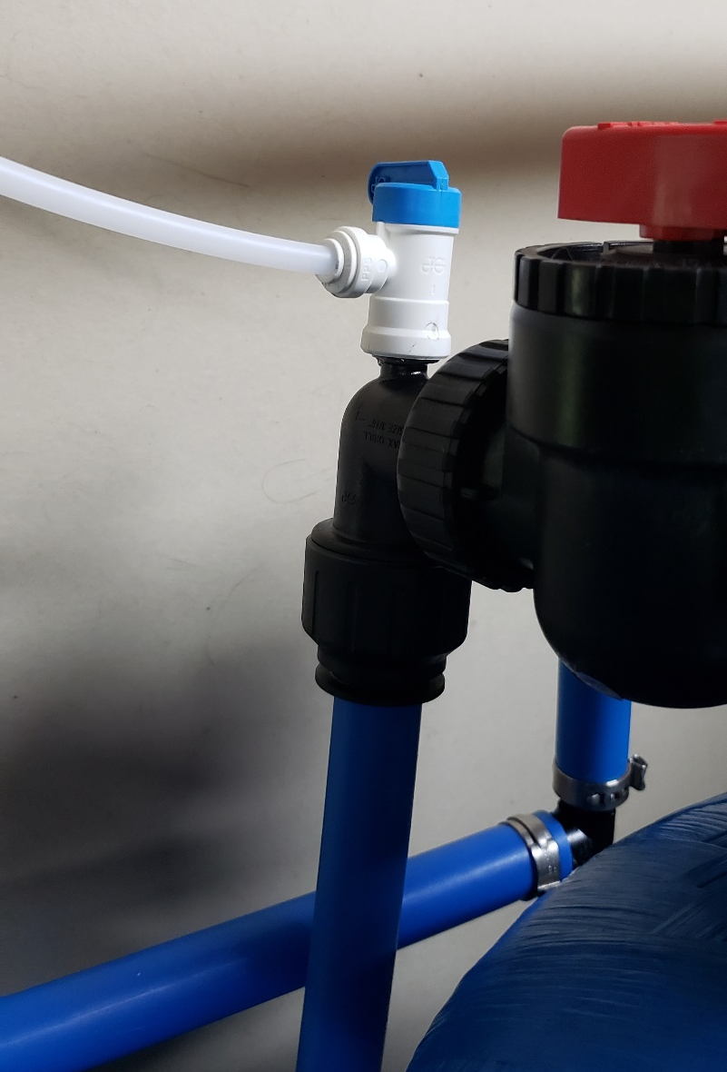
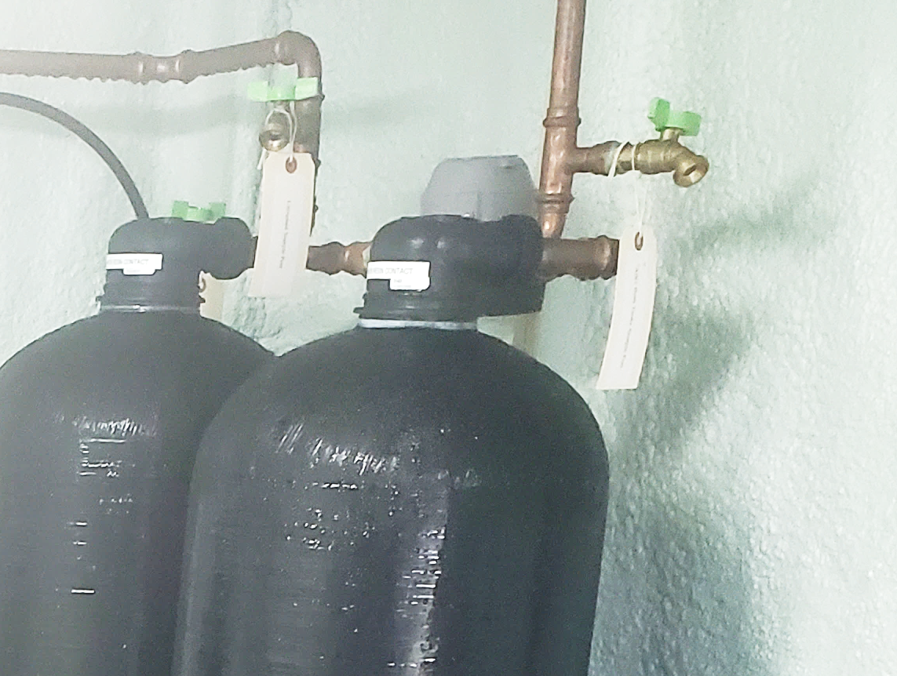
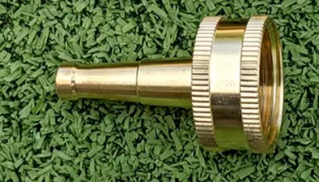
Sample Locations
At sample Port
Pressure tank if needed

Slide 5
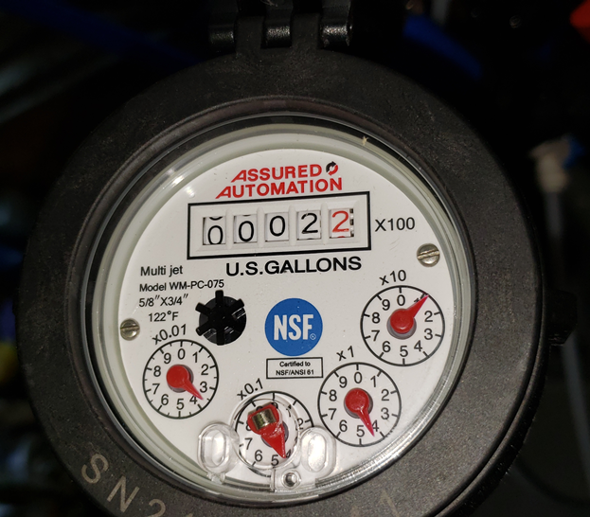
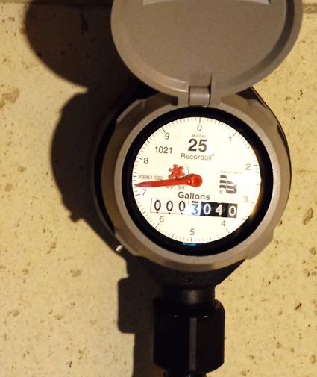
Totalizer

Slide 6
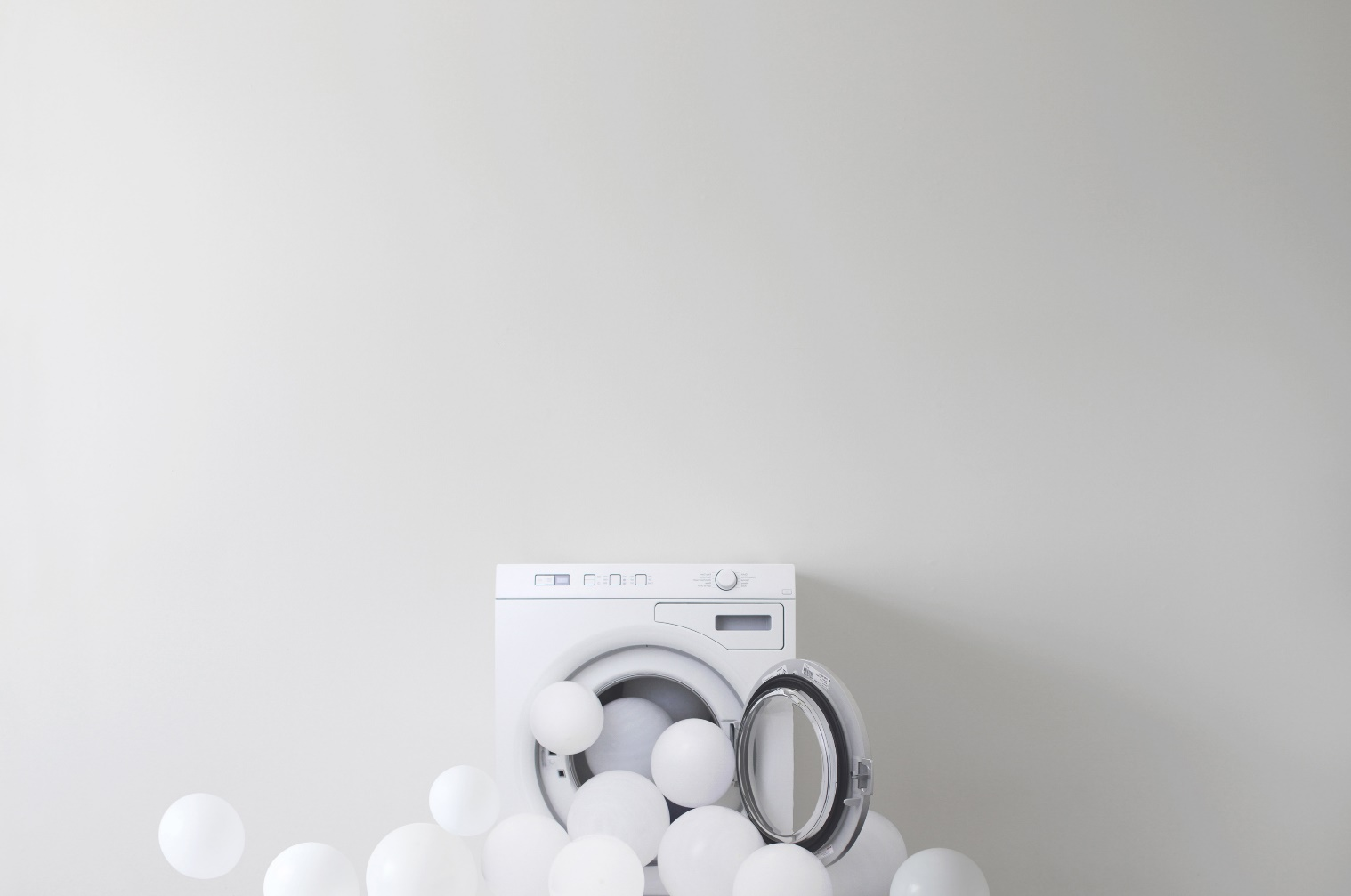
Things to Use or (Avoid)
Gloves
  (Lotions and sunscreen)
Lab Coat or Coveralls
  (Dryer sheets)
Ballpoint pens or Sharpies
HDPE
  (LDPE, Teflon)
Printed Field Sheets
  (Write-in-the-Rain)

Slide 7
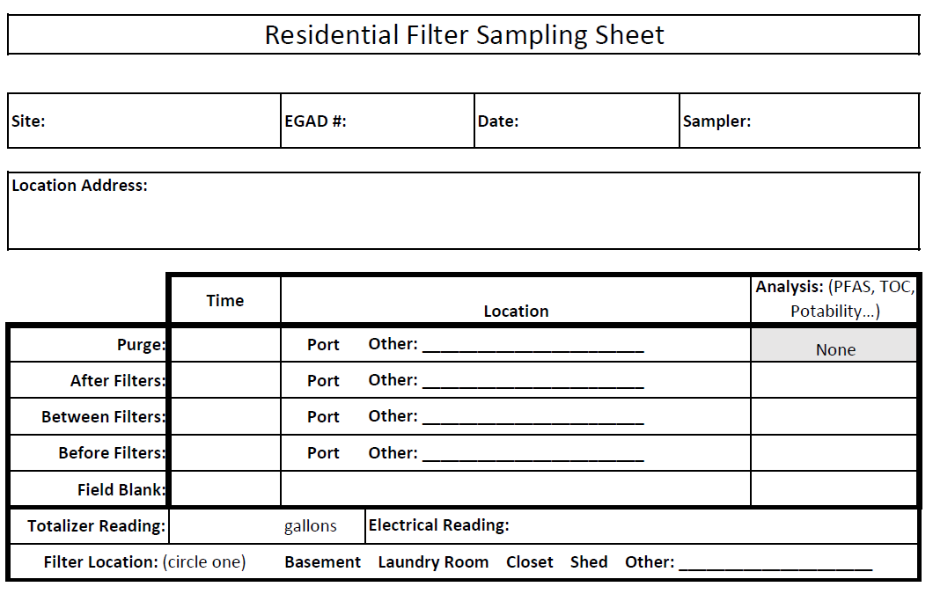
Field Sheets
Electrical Reading:

Slide 8
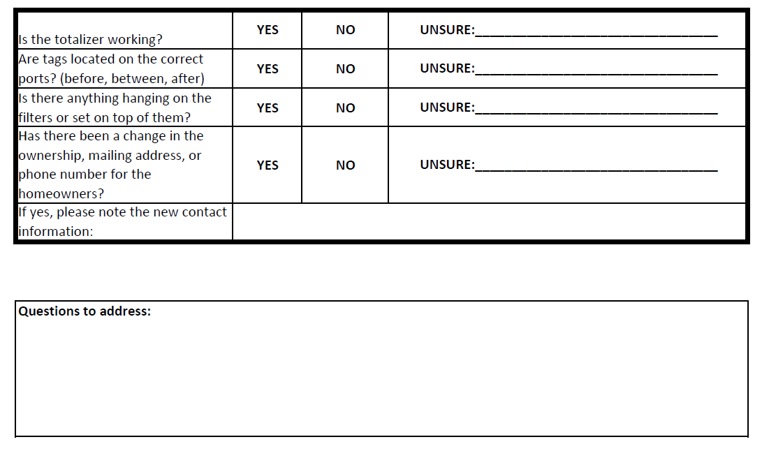
Notes:
Note electrical meter reading if in a shed

Slide 9
Matt Burke
Matthew.T.Burke@maine.gov

