Slide 1
PFAS Scheduling
Tips and Tricks
Becky Blais
OHMS II
Maine DEP, BRWM

Slide 2
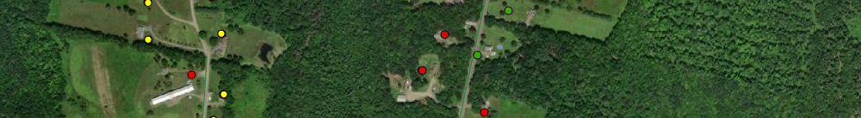
Sampling Frequency
New filters - 3 to 4 weeks post-installation
Afterwards - Sampled monthly or quarterly
  Initial raw water sample sum of 6 > 1,000ppt - MONTHLY
  Initial raw water sample sum of 6 < 1,000ppt - QUARTERLY
  Any breakthrough between filters - MONTHLY

Slide 3
Planning for Filter Sampling
30 minute time slot for each home
    Confirm contact info
    Purge system
    Sample Call if more than
    Travel to next location 15 minutes late!

Slide 4

Flexible vs. Not Flexible?
  Homeowner gets two calls:
    First Call to Schedule
      Flexible - Tell them we will call back
      the day before with their time.
      Not flexible - give a 30-minute time
      slot up front.
    Courtesy call the day before
      Reminder of sampling
      Provide specific 30-minute time slot
Notes:
Flexible - Homeowner available all day
Not Flexible – they work and will only be home early in the morning, late after work…
Provides scheduler with flexibility within the schedule
Some people will not be available that day
Be Flexible – Give them the option of 2 or 3 days
Remember – You will see these folks every month, so being pushy and forceful isn’t going to make it pleasant

Slide 5

Teams of two…
DEP has been sending two or three teams of two (2) samplers:
  Easier to manage equipment, paperwork, and questions
  Can have multiple homes with the same time slot
10-12 sample locations per team
  Beware of heat in summer
  Schedule meals and bathroom breaks as appropriate

Slide 6
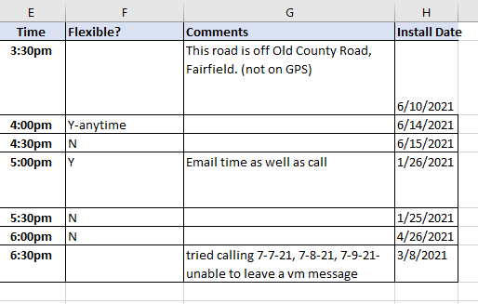
Other Useful Tips
Keep notes in the “Comments” column
Pre-sample meeting with sampling teams
Some labs can provide pre-filled labels
Pre-fill COCs for samplers
Notes:
Screening out a site:
If you have an old gas station site where a VI pathway was not originally assessed and this site comes back in to the DEP for one reason or another, if we have some old soil borings that show no saturated soil within 30 feet of a receptor, we can screen that site out. (Pathway not complete!)

Slide 7

Potential Issues with Scheduling
  May be hard to contact owners:
    Some screen calls (spam calls)
    Voicemail box is full
    Might not have voicemail
  Keep calling
  Send a paper letter
  Final resort - knock on the door while out sampling

Slide 8
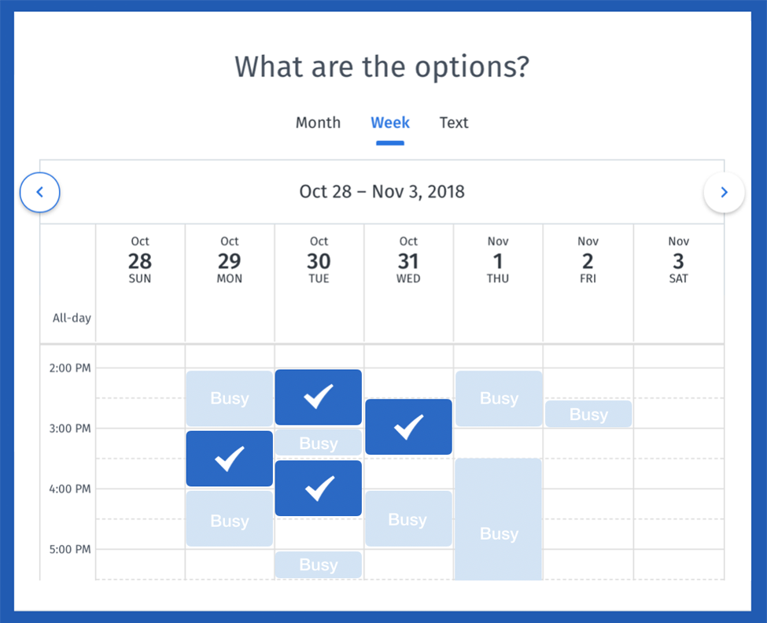
Going Forward…
  Recommend an online or automated scheduling system
    Some residents only have landlines and are elderly
    Online signup – many options
    Email
    Calling is very time consuming
  Send a reminder the day before
    Send via text or email
    Homeowners don’t always remember!

Slide 9
Becky Blais
Becky.Blais@maine.gov

