Slide 1

Regional Haze Related Analyses
Tom Downs
Chief Meteorologist, Atmospheric Science & Analysis Section
Air Quality Assessment Division in the Bureau of Air Quality
Tom.Downs@maine.gov
MAINE DEPARTMENT OF ENVIRONMENTAL PROTECTION
Protecting Maine’s Air, Land and Water
1

Slide 2
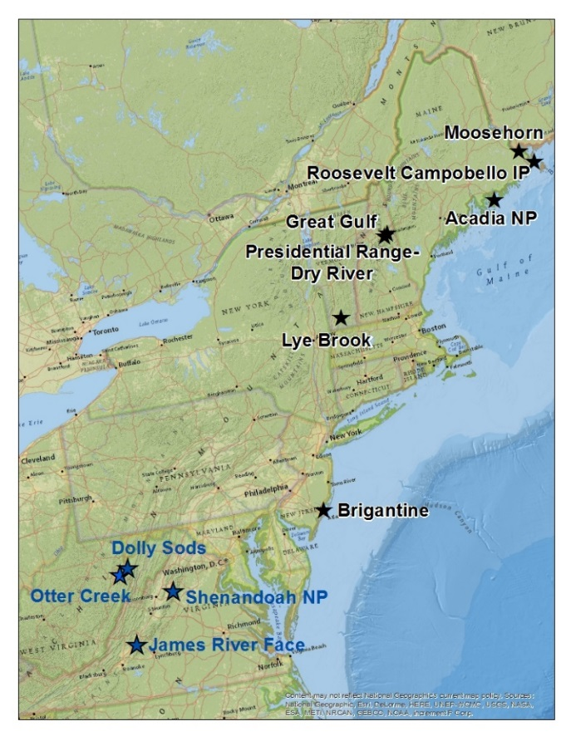
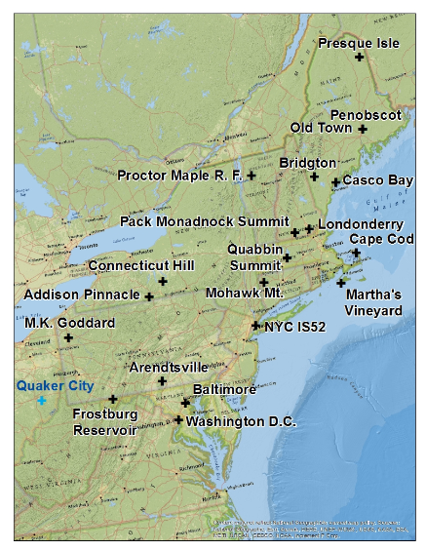
Class I Areas
IMPROVE Protocol Sites
MAINE DEPARTMENT OF ENVIRONMENTAL PROTECTION www.maine.gov/dep
2

Slide 3
MAINE IMPROVE CLASS I SITE ANALYSES
MAINE DEPARTMENT OF ENVIRONMENTAL PROTECTION www.maine.gov/dep
3

Slide 4
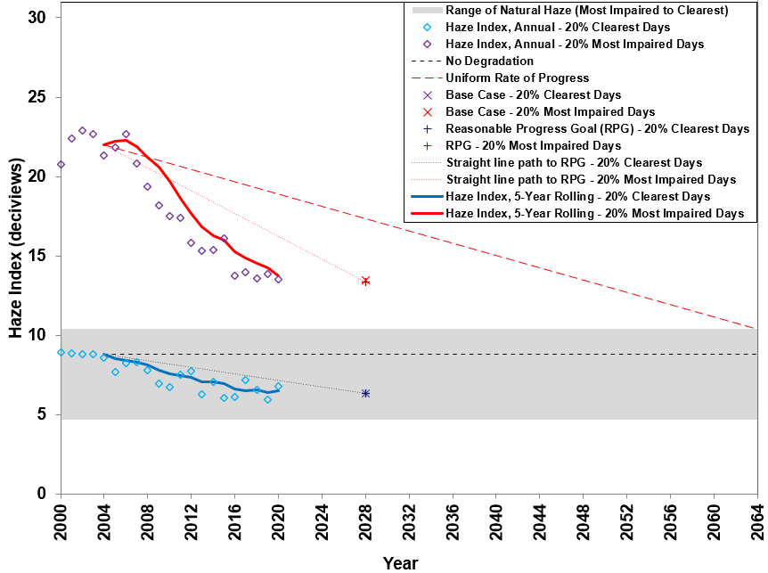
Acadia National Park Visibility Trends
MAINE DEPARTMENT OF ENVIRONMENTAL PROTECTION www.maine.gov/dep
4

Slide 5
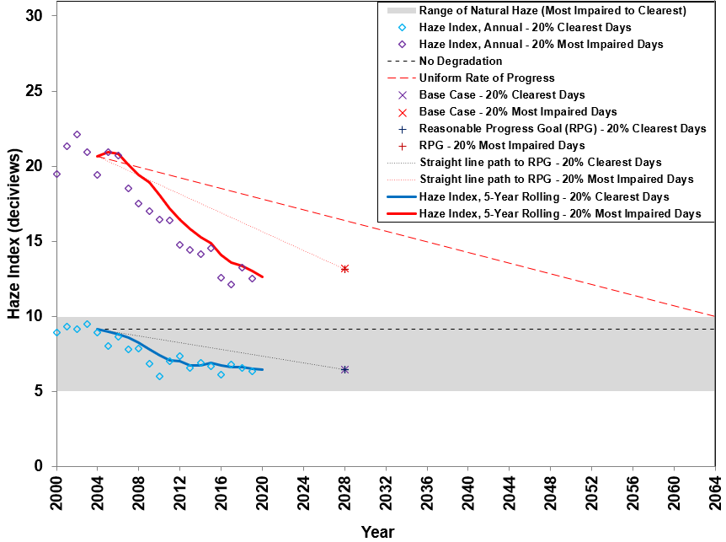
Moosehorn Wilderness Area Visibility Trends
MAINE DEPARTMENT OF ENVIRONMENTAL PROTECTION www.maine.gov/dep
5

Slide 6
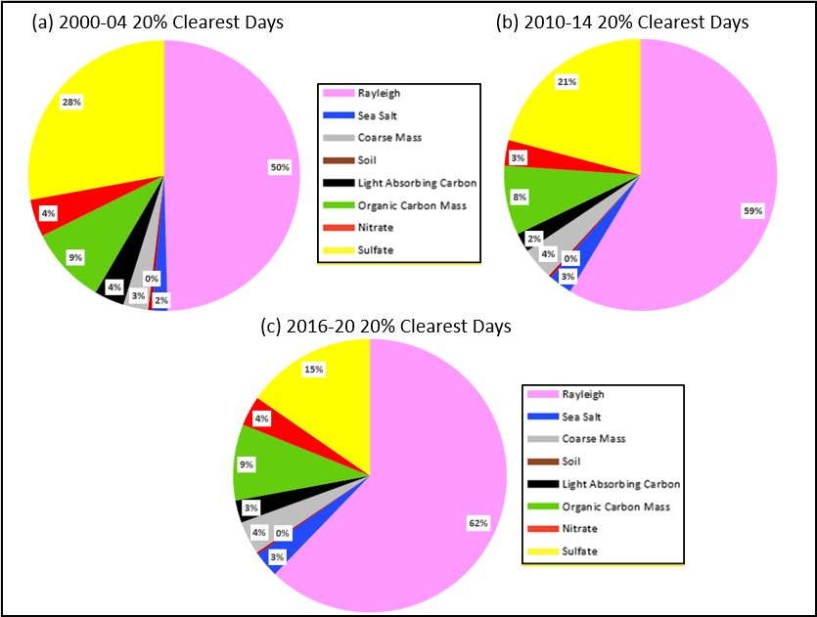
Acadia National Park 20% Clearest Days Speciation Trends
MAINE DEPARTMENT OF ENVIRONMENTAL PROTECTION www.maine.gov/dep
6

Slide 7
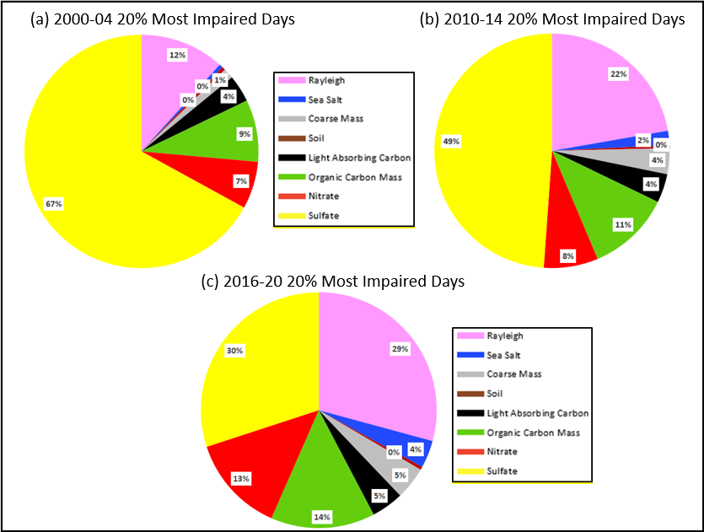
Acadia National Park 20% Most Impaired Days Speciation Trends
MAINE DEPARTMENT OF ENVIRONMENTAL PROTECTION www.maine.gov/dep
7

Slide 8
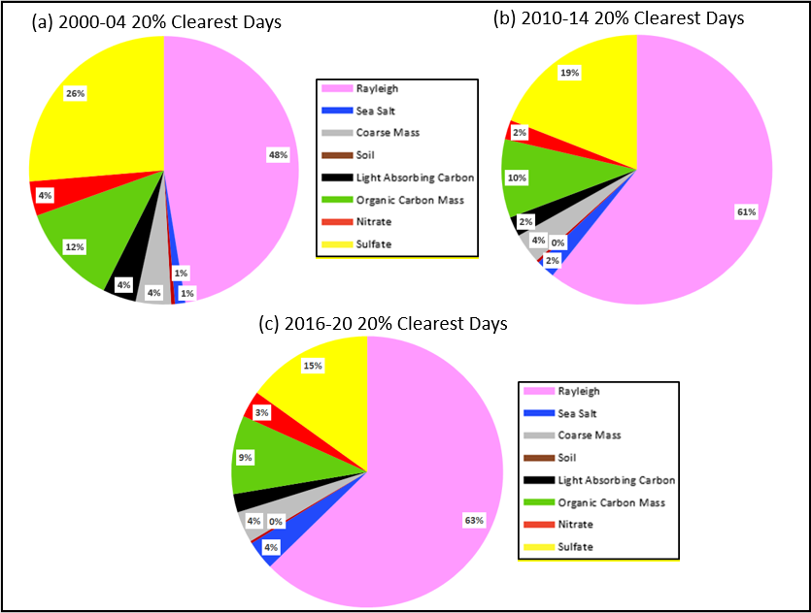
Moosehorn Wilderness Area 20% Clearest Days Speciation Trends
MAINE DEPARTMENT OF ENVIRONMENTAL PROTECTION www.maine.gov/dep
8

Slide 9
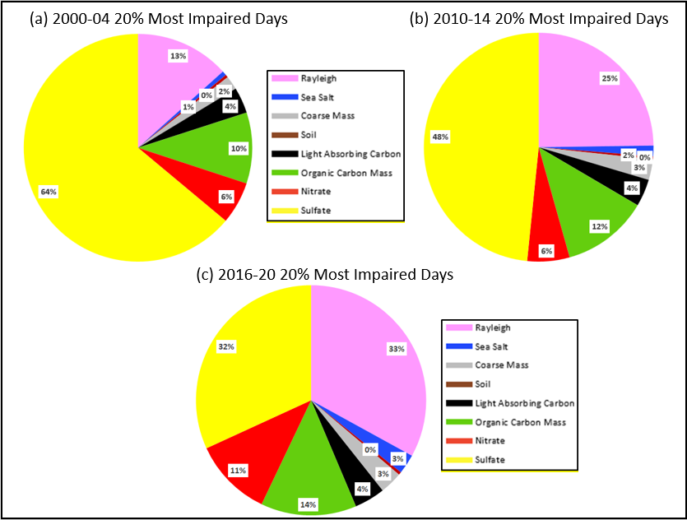
Moosehorn Wilderness Area 20% Most Impaired Days Speciation Trends
MAINE DEPARTMENT OF ENVIRONMENTAL PROTECTION www.maine.gov/dep
9

Slide 10
McFarland Hill Sunset (Thermo) Sulfate (SO4) and Total Carbon (Organic Carbon (OC) and Elemental Carbon (EC)) analyses
MAINE DEPARTMENT OF ENVIRONMENTAL PROTECTION www.maine.gov/dep
10

Slide 11
MAINE DEPARTMENT OF ENVIRONMENTAL PROTECTION www.maine.gov/dep
11

Slide 12
MAINE DEPARTMENT OF ENVIRONMENTAL PROTECTION www.maine.gov/dep
12

Slide 13
MAINE IMPROVE PROTOCOL SITE ANALYSES
MAINE DEPARTMENT OF ENVIRONMENTAL PROTECTION www.maine.gov/dep
13

Slide 14
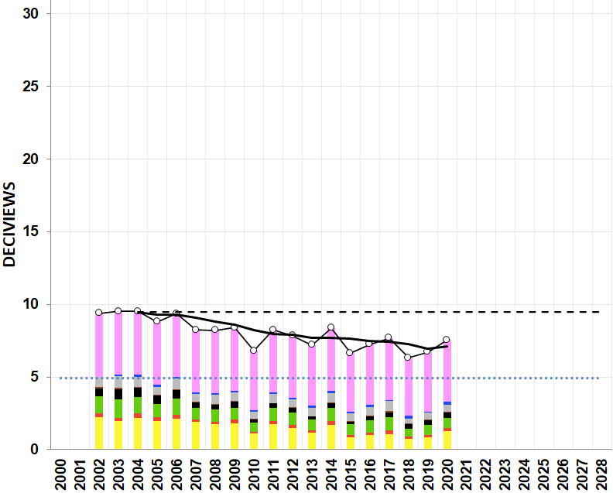
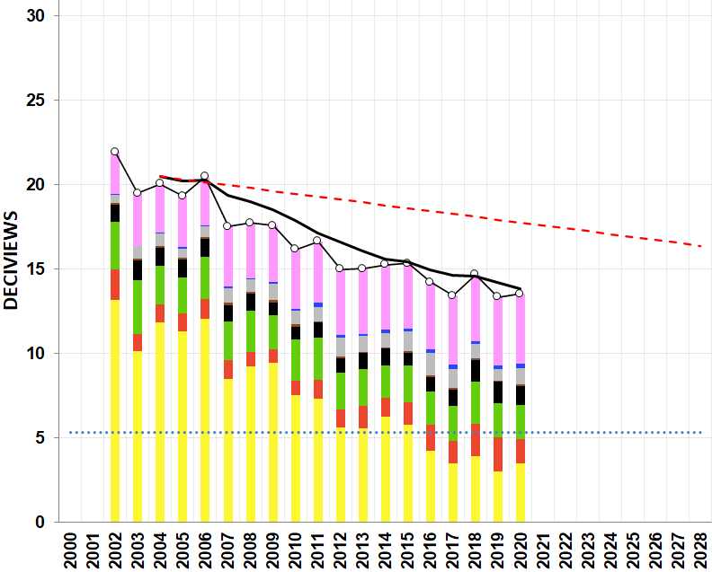
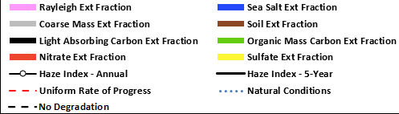
Presque Isle Speciation Trends
(a) 20% Clearest Days
(b) 20% Most Impaired Days
MAINE DEPARTMENT OF ENVIRONMENTAL PROTECTION www.maine.gov/dep
14

Slide 15
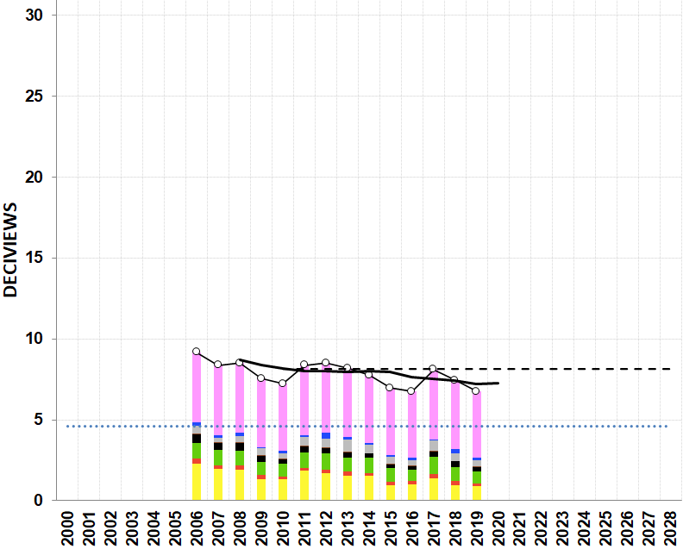
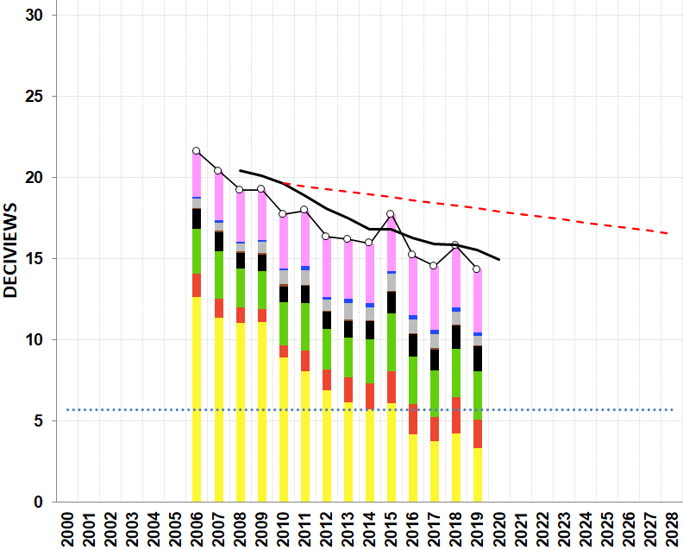
Penobscot Nation Speciation Trends
(a) 20% Clearest Days
(b) 20% Most Impaired Days
MAINE DEPARTMENT OF ENVIRONMENTAL PROTECTION www.maine.gov/dep
15

Slide 16
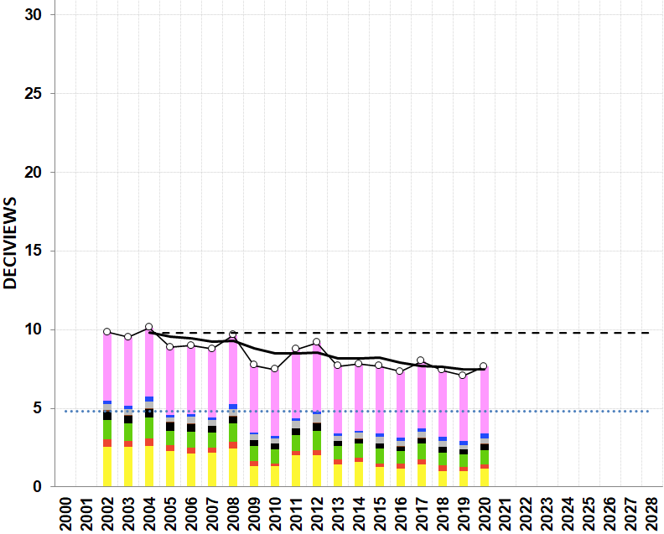
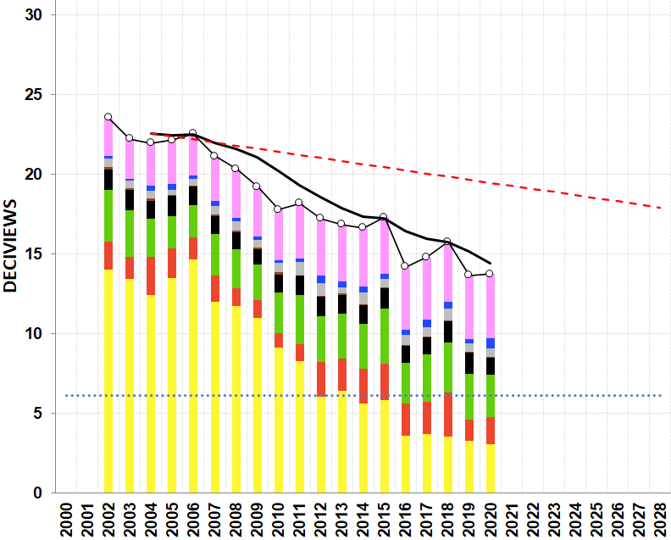
Casco Bay Speciation Trends
(a) 20% Clearest Days
(b) 20% Most Impaired Days
16
MAINE DEPARTMENT OF ENVIRONMENTAL PROTECTION www.maine.gov/dep

Slide 17
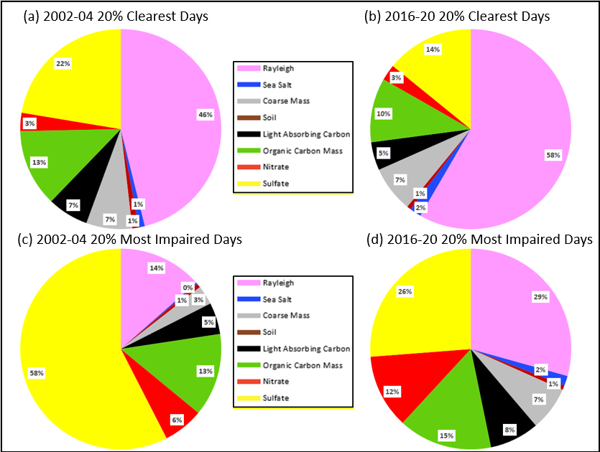
Presque Isle Baseline and Current Speciation Trends
MAINE DEPARTMENT OF ENVIRONMENTAL PROTECTION www.maine.gov/dep
17

Slide 18
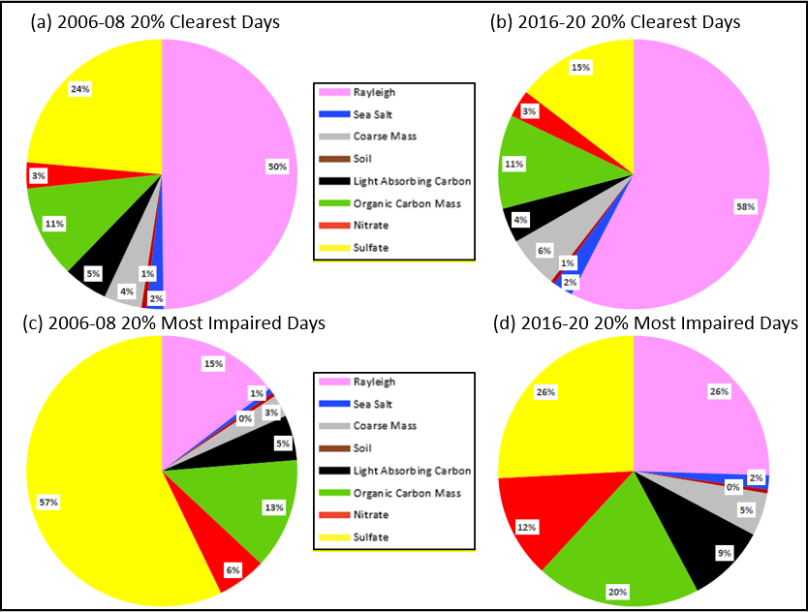
Penobscot Nation Baseline and Current Speciation Trends
MAINE DEPARTMENT OF ENVIRONMENTAL PROTECTION www.maine.gov/dep
18

Slide 19
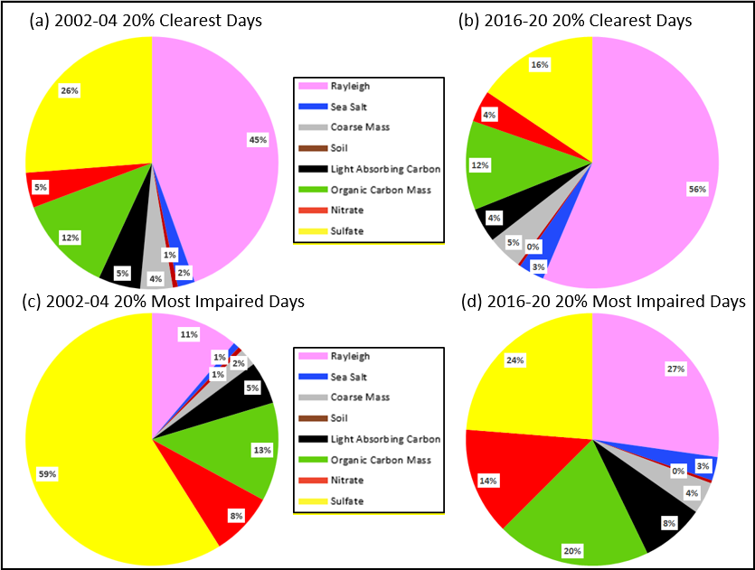
Casco Bay Baseline and Current Speciation Trends
MAINE DEPARTMENT OF ENVIRONMENTAL PROTECTION www.maine.gov/dep
19

Slide 20

www.maine.gov/dep
CONTACT:
Tom Downs
Chief Meteorologist, Atmospheric Science & Analysis Section
Air Quality Assessment Division in the Bureau of Air Quality
Tom.Downs@maine.gov
20

