Slide 1

OZONE Monitoring Network
2022 Annual AQ Monitoring Meeting
Tom Downs
Chief Meteorologist, Atmospheric Science & Analysis Section
Air Quality Assessment Division in the Bureau of Air Quality
Tom.Downs@maine.gov
MAINE DEPARTMENT OF ENVIRONMENTAL PROTECTION
Protecting Maine’s Air, Land and Water
1

Slide 2
2021 Ozone Season Review
MAINE DEPARTMENT OF ENVIRONMENTAL PROTECTION www.maine.gov/dep
2

Slide 3
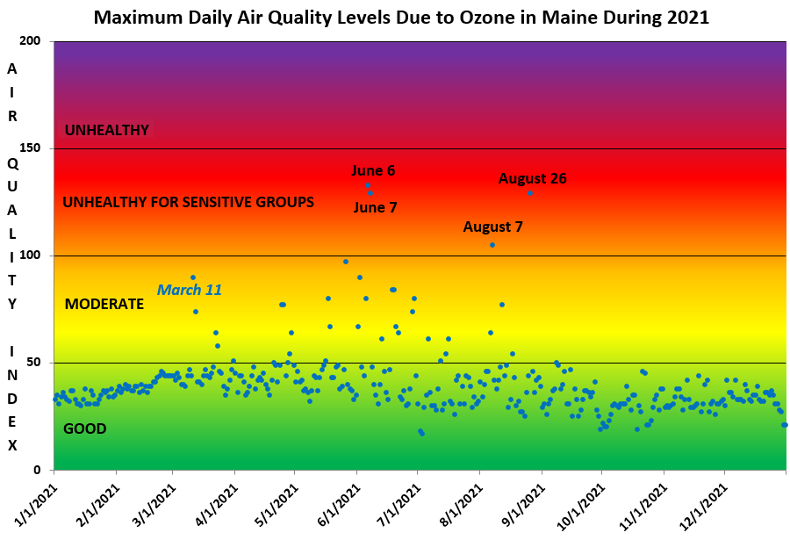
MAINE DEPARTMENT OF ENVIRONMENTAL PROTECTION www.maine.gov/dep
3

Slide 4
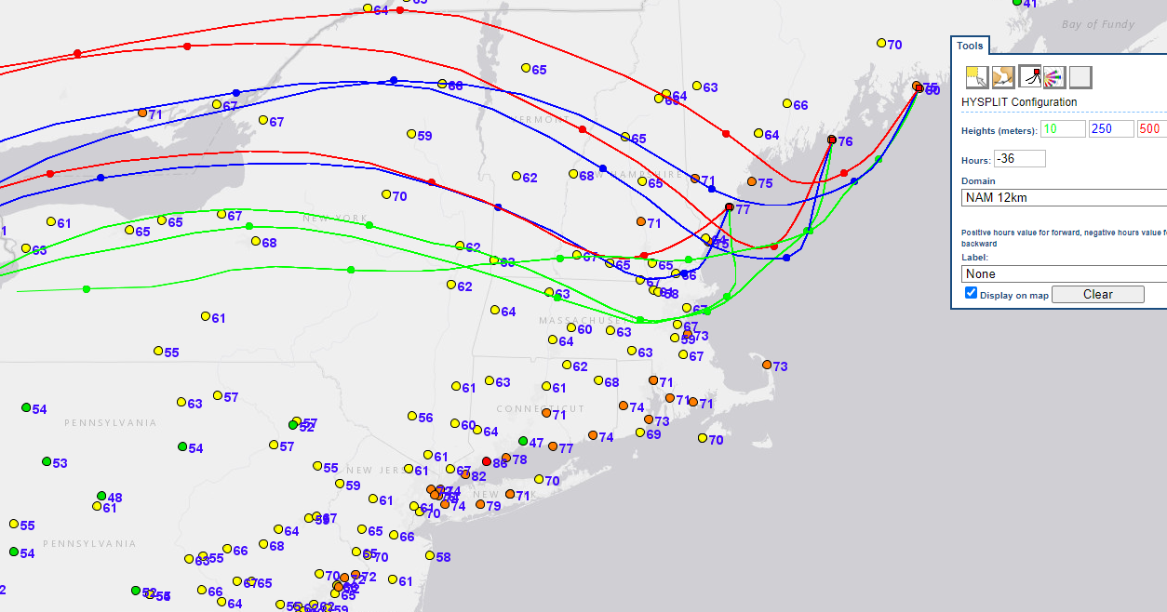
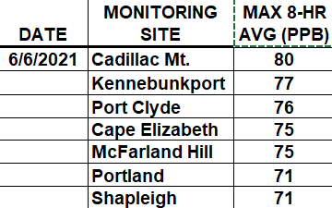
June 6, 2021 Maximum 8-hour Ozone levels w/back trajectories
MAINE DEPARTMENT OF ENVIRONMENTAL PROTECTION www.maine.gov/dep
4

Slide 5
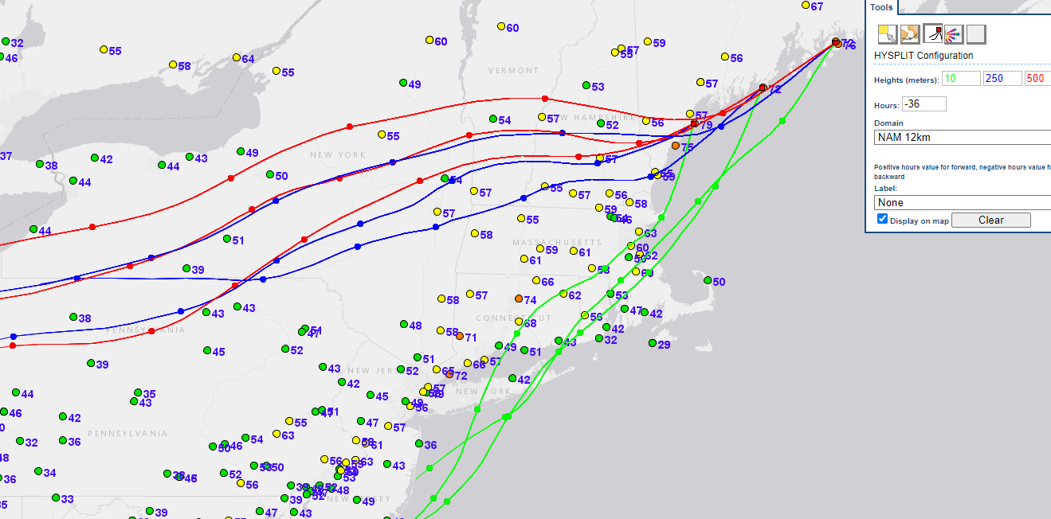
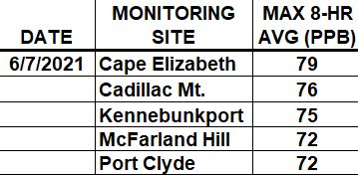
June 7, 2021 Maximum 8-hour Ozone levels w/back trajectories
MAINE DEPARTMENT OF ENVIRONMENTAL PROTECTION www.maine.gov/dep
5

Slide 6
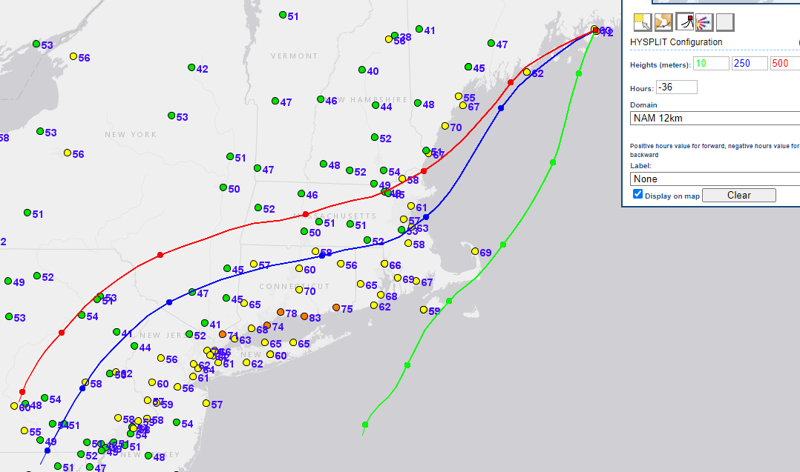

August 7, 2021 Maximum 8-hour Ozone levels w/back trajectories
MAINE DEPARTMENT OF ENVIRONMENTAL PROTECTION www.maine.gov/dep
6

Slide 7
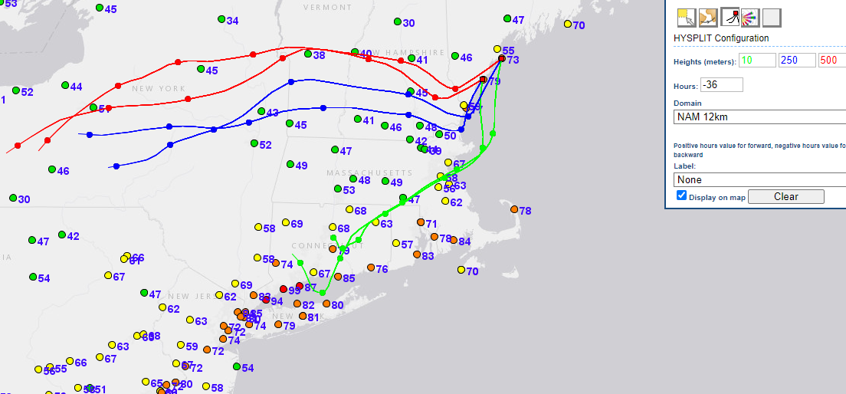
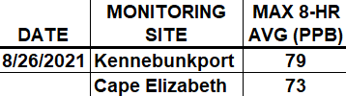
August 26, 2021 Maximum 8-hour Ozone levels w/back trajectories
MAINE DEPARTMENT OF ENVIRONMENTAL PROTECTION www.maine.gov/dep
7

Slide 8
Design Values and Trends
MAINE DEPARTMENT OF ENVIRONMENTAL PROTECTION www.maine.gov/dep
8

Slide 9
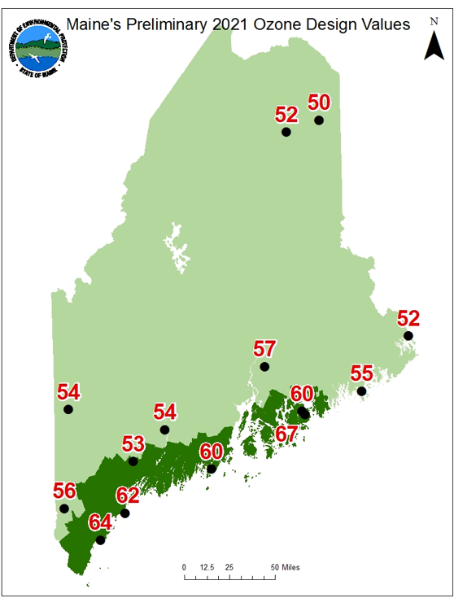
NOTE: As of March 14, areas shown in the lighter green color will no longer be in the Ozone Transport Region
MAINE DEPARTMENT OF ENVIRONMENTAL PROTECTION www.maine.gov/dep
9

Slide 10
Maine sites in the Ozone Transport Region
Maine sites no longer in the Ozone Transport Region
MAINE DEPARTMENT OF ENVIRONMENTAL PROTECTION www.maine.gov/dep
10

Slide 11
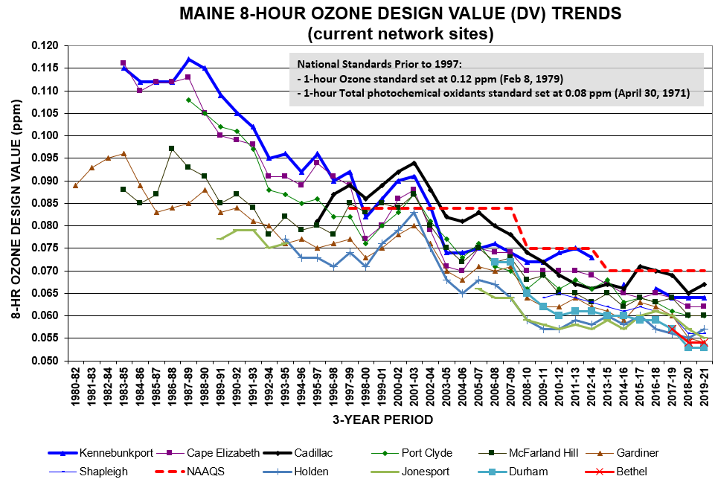
Maine sites in the Ozone Transport Region
MAINE DEPARTMENT OF ENVIRONMENTAL PROTECTION www.maine.gov/dep
11

Slide 12
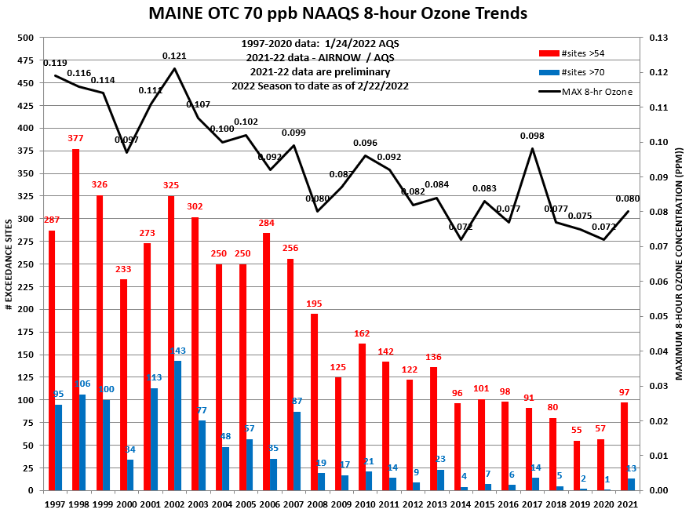
12
MAINE DEPARTMENT OF ENVIRONMENTAL PROTECTION www.maine.gov/dep

Slide 13
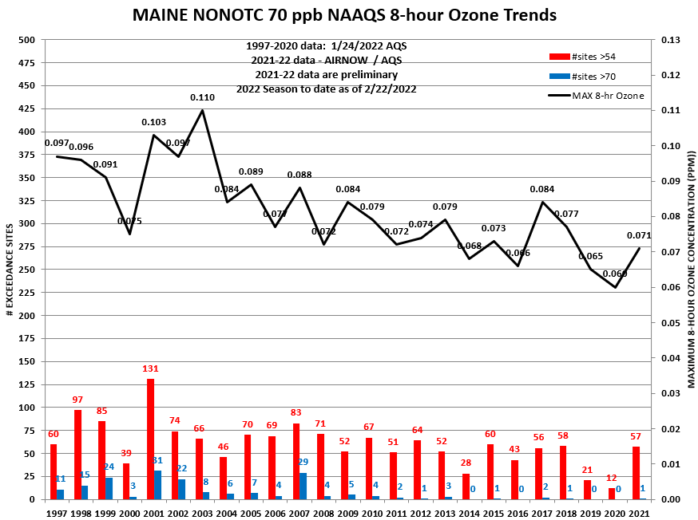
MAINE DEPARTMENT OF ENVIRONMENTAL PROTECTION www.maine.gov/dep
13

Slide 14
Proposed 2022-23 Ozone Network
MAINE DEPARTMENT OF ENVIRONMENTAL PROTECTION www.maine.gov/dep
14

Slide 15
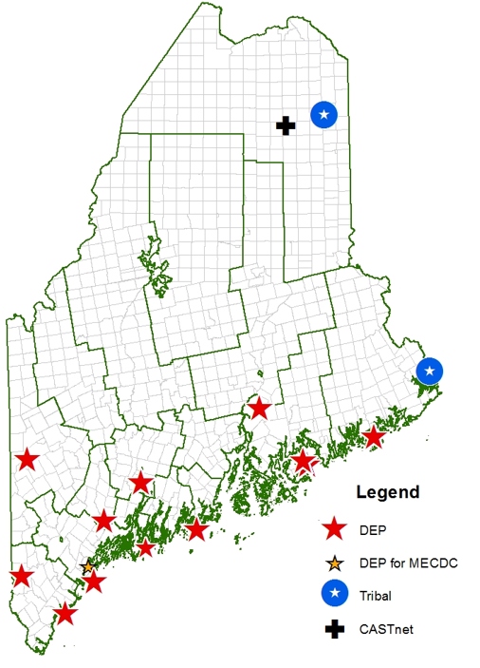
2022-23 Ozone Network
Popham Beach (new)
MAINE DEPARTMENT OF ENVIRONMENTAL PROTECTION www.maine.gov/dep
15

Slide 16

www.maine.gov/dep
CONTACT:
Tom Downs
Chief Meteorologist, Atmospheric Science & Analysis Section
Air Quality Assessment Division in the Bureau of Air Quality
Tom.Downs@maine.gov
16

