Slide 1
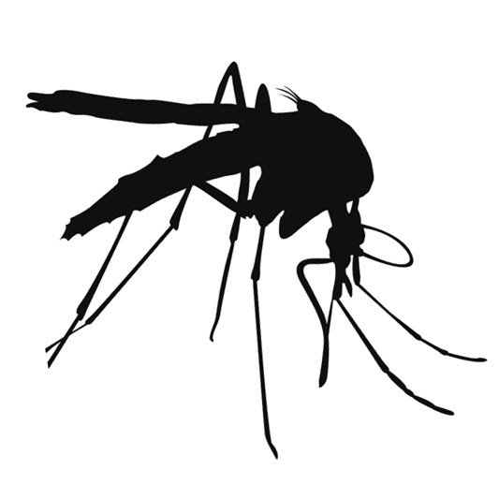
Mosquito Trivia Face-Off

Slide 2

What does a female mosquito use to pierce the skin?
Answer

Slide 3
Why do female mosquitoes need blood?
Answer

Slide 4
What do male mosquitoes feed on?
Answer

Slide 5
What part of the mosquito’s body do their legs attach to?
Answer

Slide 6
What part of the mosquito body fills up with blood?
Answer

Slide 7
What is the process of development from immature to adult mosquito called?
Answer

Slide 8
What is the third stage of a mosquito’s life cycle?
Answer

Slide 9
What is the long feathery organ used to hear and smell?
Answer

Slide 10
What is essential for mosquitoes to complete their life cycle?
Answer

Slide 11
What is an example of a natural container where mosquitoes breed?
Answer

Slide 12
What type of habitat has water sources present for long periods of time?
Answer

Slide 13
What type of habitat has water sources that alternate between wet and dry?
Answer

Slide 14
What do mosquitoes use to find a host when they get closer to the host?
Answer

Slide 15
What is a normal predator of mosquito larvae?
Answer

Slide 16
What is the nickname for the larva stage of the mosquito?
Answer

Slide 17
What is the nickname for the pupa stage of the mosquito?
Answer

Slide 18
How many species of mosquitoes are currently found in Maine?
Answer

Slide 19
How many eggs do females usually lay at one time?
Answer

Slide 20
What is an example of a man-made container that can collect water?
Answer

Slide 21
How often should you empty standing water so that mosquito larvae won’t have time to complete their life cycle?
Answer

Slide 22
What is the man-made container that is the most common breeding site for mosquitoes around the home?
Answer

Slide 23
What type of shirt will lower your chances of getting bitten by a mosquito?
Answer

Slide 24
What clothes that you wear on your bottom half will lower your chances of getting bitten by a mosquito?
Answer

Slide 25
What agency should mosquito repellent be approved by?
Answer

Slide 26
Name one repellent that is approved for use on skin?
Answer

Slide 27
What repellent is approved for use on clothing?
Answer

Slide 28
Which repellent is a natural repellent?
Answer

Slide 29
Name one symptom of EEE, JCV, or WNV?
Answer

Slide 30
How do mosquitoes detect a human they want to bite from far away?
Answer

Slide 31
What is one of the mosquito-borne disease endemic in Maine?
Answer

Slide 32
Where in the US is EEE found?
Answer

Slide 33
Where in the US is WNV found?
Answer

Slide 34
What is the term for a host that cannot transmit the virus to others?
Answer

Slide 35
What is the term for an organism that transmits the pathogen from one animal to another?
Answer

Slide 36
What is the term for an animal that a mosquito can feed on?
Answer

Slide 37
When are mosquitoes that can carry EEE, JCV, and WNV most active?
Answer

Slide 38
What is the process called when a bird infects a mosquito that can then infect another bird?
Answer

Slide 39
What role does a bird play in the transmission cycle?
Answer

Slide 40
What role does a mosquito play in the transmission cycle?
Answer

Slide 41
What role does a human or horse play in the transmission cycle?
Answer

Slide 42
How many stages does the life cycle of a mosquito consist of?
Answer

Slide 43
If you are infected with a mosquito-borne illness, how long will it take for symptoms to appear?
Answer

Slide 44
If you are infected with a mosquito-borne illness, how long do symptoms usually last?
Answer

Slide 45
What is the treatment for mosquito-borne illness?
Answer

Slide 46
Abdomen
Back

Slide 47
Proboscis
Back

Slide 48
Plant nectar
Back

Slide 49
Pupa
Back

Slide 50
To lay eggs
Back

Slide 51
Thorax
Back

Slide 52
Antenna
Back

Slide 53
Metamorphosis
Back

Slide 54
Water
Back

Slide 55
Spots between branches of trees or holes formed in trees where water collects, puddles.
Back

Slide 56
Permanent water
Back

Slide 57
Flood water
Back

Slide 58
Heat, moisture, or vision
Back

Slide 59
Fish, birds, or dragonflies
Back

Slide 60
Wigglers or wrigglers
Back

Slide 61
Tumblers
Back

Slide 62
45
Back

Slide 63
50-300
Back

Slide 64
Tires, buckets, flower pots, pet bowls, catch basin, bird baths.
Back

Slide 65
At least once per week
Back

Slide 66
Old or unmounted tires
Back

Slide 67
Long sleeved shirt
Back

Slide 68
Long pants
Back

Slide 69
Environmental Protection Agency (EPA)
Back

Slide 70
DEET, IR3535, Picaridin, Oil of lemon eucalyptus
Back

Slide 71
Permethrin
Back

Slide 72
Oil of lemon eucalyptus
Back

Slide 73
Headache, fever, vomiting, feeling tired, encephalitis, meningitis, stiff neck, paralysis, seizures
Back

Slide 74
Carbon dioxide, which we exhale when we breath
Back

Slide 75
EEE, JCV, WNV
Back

Slide 76
EEE is typically found on the east coast
Back

Slide 77
Throughout the continental U.S.
Back

Slide 78
A dead-end host
Back

Slide 79
Vector
Back

Slide 80
A host
Back

Slide 81
Dawn and dusk
Back

Slide 82
Amplification cycle
Back

Slide 83
A host
Back

Slide 84
A vector
Back

Slide 85
A dead-end host
Back

Slide 86
Four stages
Back

Slide 87
3-18 days after infection
Back

Slide 88
1-2 weeks
Back

Slide 89
No treatment, only support
Back

