Slide 1
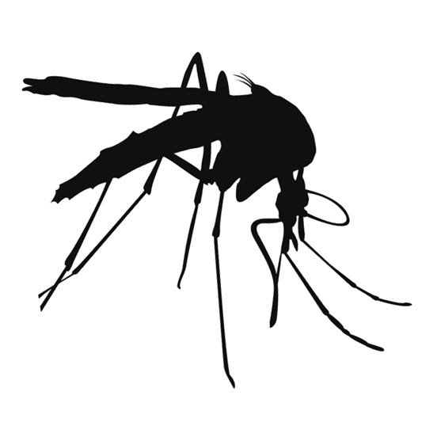
Mosquito Hot Spots
Mosquitoes can breed in natural and man-made containers of water. Can you find all the hot spots where mosquitoes could lay eggs?

Slide 2
