Slide 1


Education is Special
A Guide to Special Education in Maine
Notes:
Dylan and Allison
MPF, Who we are, What we do.
-Maine’s Parent Training information Center
-provide trainings like this, create family friendly resources
-Parent information Specialists available via email and phone to answer questions
-If we don’t know the answers, we will find someone who does
Maine F2F program
-Provide Parent to Parent Support via Family Support Navigators program
-Parents with lived experience navigating the different systems of care.
-Trained with MPF trainings
-provide assistance, support
-help organizing paperwork, help applications through different programs, MaineCare Katie Beckett sit in with you during IEP meetings,
Education Special is our General Guide to Special Education in Maine. We also have other trainings Transitioning to K, and Transitioning from HS, Supported Decision Making:

Slide 2
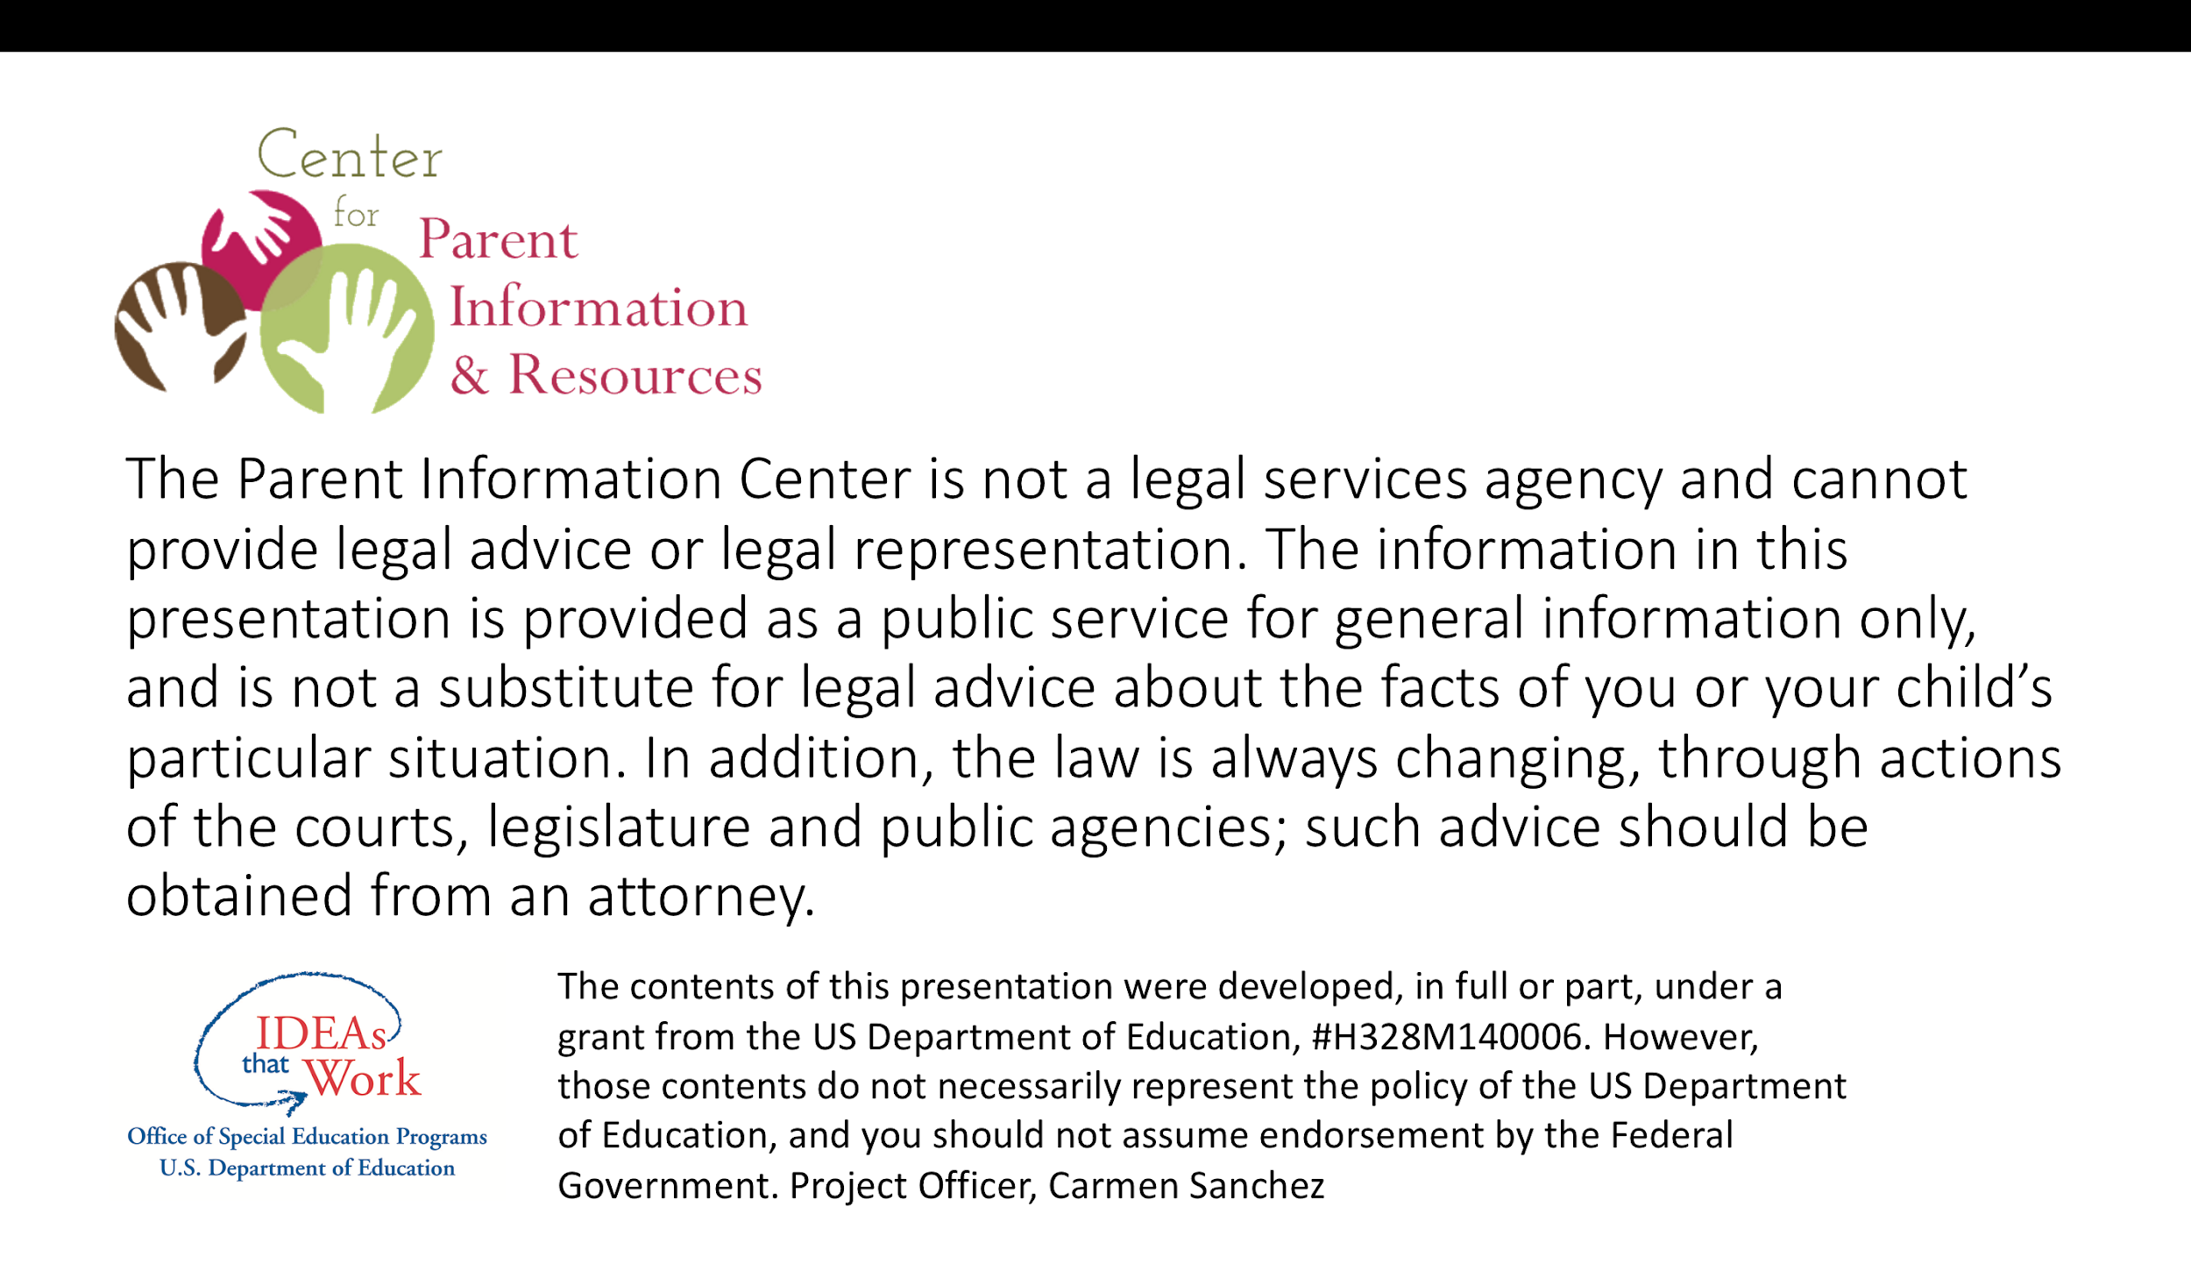

Notes:
Dylan
We are not experts, we like to consider ourselves generalists. Maine Parent Federation is not a legal services agency and cannot provide legal advice or representation.

Slide 3

Today’s Topics
Introduction to Special Education Regulations
The Purpose & Structure of the IEP/504
Procedural Safeguards & Due Process
Notes:
Dylan
Special Education is a large and complex topic. We are not expecting you to walk away today being an expert of special education law, rather we hope this presentation allow you to become familiar with the general structure of special education in Maine, some of the common terms you will encounters, and the pathways of addressing disuptes.

Slide 4


All public educations is provided by the Federal and State Departments of Education.
Notes:
Dylan

Slide 5

Who oversees Special Education?
Federal:
Special Education (SPED) is mandated by the Individuals with Disabilities Education Act (IDEA) which is overseen by the federal Office of Special Education Programs (OSEP)
State:
Mandated by the Maine Unified Special Education Regulations (MUSER) or Chapter 101 which is overseen by Maine Department of Education Office of Special Services
Notes:
Dylan:
At the federal level, special education is mandated by IDEA, and overseen by the federal office of special education programs (OSEP)
At the state level, special education is mandated by Maine’s Unified Special Education Regulations, also known as MUSER or Chapter 101, and overseen by Maine Department of Education Office of Special Services.
MPF has a voice at the state level and attends a yearly conference put on by OSEP, as we have a grant from them.

Slide 6

The Individuals with Disabilities Education Act is a law to provide federal financial assistance to State and local education agencies to ensure a Free and Appropriate Public Education (FAPE) via special education programs and related services to eligible children with disabilities .
Notes:
Dylan
The right to a Free Appropriate Public Education is an educational entitlement of all students in the United States who are identified as having a disability, guaranteed by the Rehabilitation Act of 1973 and the Individuals with Disabilities Education Act.
All public schools must follow IDEA to receive federal funding.

Slide 7
There are 4 Parts of IDEA
Part A
Lays out the foundation for the rest of the Act
Defines the terms used within the Act
Provides for the creation of the Office of Special Education Programs*
*OSEP is responsible for administering and carrying out the terms of IDEA.
Notes:
Dylan: General Provisions of the Law

Slide 8
There are 4 Parts of IDEA
Part B-B-619
Lays out the educational guidelines for school children age 3-22
Declares states are required to educate students with disabilities
Provides financial support for state and local school districts
Part B-619 details guidelines for children 3-5
Notes:
Dylan: Assistance for Education of All Children with Disabilities

Slide 9
There are 4 Parts of IDEA
Part C
Recognizes the need for early intervention (EI) for young children with disabilities by:
Providing guidelines concerning the funding and services for children birth through 2 years old
Identifying who is responsible for child find at this age
Indicating eligible services for families through part C of IDEA
Identifying who is responsible for providing services.
Notes:
Dylan: Part C is responsible for indicating who gets the service, what services are available and which agency provides the services- Birth through 2 years- Infants and Toddlers with Disabilities

Slide 10
There are 4 Parts of IDEA
Part D
Describes national activities to improve the education of children with disabilities
Includes grants to improve the education and transitional services provided to students with disabilities
Provides resources to support programs, projects and activities which contribute positive results for children with disabilities.
*Maine Parent Federation receives part of its funding through part D
Notes:
Dylan:
National Activities to Improve Education of Children with Disabilities
Our grants from the Office of Special Education are funded through this law

Slide 11
Maine’s Unified Special Education Regulations
(MUSER or Chapter 101)
MUSER is Maine’s interpretation of IDEA, the federal law which enforces the rights for children with disabilities.
Notes:
Dylan
MUSER is Maine’s special education law, and must meet or exceed the federal law IDEA

Slide 12
MUSER must meet or exceed the federal law IDEA
The language within italics is the state added language and where Maine exceeds the services, support, and protections provided in IDEA.
MUSER (Chapter 101) https://www.maine.gov/doe/cds/muser
Notes:
Dylan
Non-italicized = Language directly from IDEA
Italics = Where Maine exceeds IDEA

Slide 13
“Special Education is specially designed instruction (SDI), provided at no cost to the parents, to meet the unique needs of a child with a disability.”
Notes:
Dylan: SDI allows for the altering of curriculum to be delivered in a way which is accessible to the student.
Specially Designed Instruction is a key part defining “What is special education”

Slide 14
What does F.A.P.E. include?
Access to specially designed instruction conducted within all school classrooms
including unified arts, such as physical education, music and art
When determined appropriate by an IEP team, access to specially designed instruction received at home, or other places like hospitals
Services & accommodations
Notes:
Allison: Not limited to academic areas, but includes all aspects of the school day
goal of a least restrictive environment
Services - what is provided, including Speech, OT
Accommodations- removes barriers to edcuation
IRLP- Individualized Remote Learning Plan, temporary plan to provide FAPE safely during novel circumstances like COVID-19. not require by IDEA, however MDOE recommends IEP teams consider such a plan. should be added as an accommodation to the IEP. (Not changing the IEP goals, services during COVID-19, rather adding an accommodation to receive FAPE remotely)

Slide 15
Examples of Services
Examples of Accommodations
Extra time for all school work, including standardized tests
Speech Therapy
Occupational Therapy
Planned motor breaks throughout the day
Physical Therapy
Preferential or flexible seating
Consultation from Specialists, ex. BCBA
Taking tests verbally, rather than written
Counseling Services
Extended School Year (ESY)
Para-professional support
Notes:
Allison: Consultation from Specialists: including Board Certified Behavioral Analysts (BCBAs) –Advanced Behaviorial Analysis Therapy
If its determined that the student is unable to retain information during extended breaks in school schedule, it is not a lot of time for students any longer, usually 3-4 days a week for a few hours each day over the summer

Slide 16






Special Education can also include instruction for
Positive Behavioral Interventions & Supports (PBIS)
Behavior Plans
Social/Emotional Skills
Independent Living Skills
Transition Plans for Adulthood
Vocational Rehabilitation (VR)
Notes:
Allison: PBIS – methods used to identify and support behavior; intended to create a positive learning environment by: feeling safe, respected, engaged in learning, involved in school life, & having a shared vision between teachers and students

Slide 17
The Individualized Education Program (IEP)
The IEP is a Document which ensures all children with disabilities have access to a Free & Appropriate Public Education (FAPE)
Indicates special education services and accommodations which will be provided based on the student’s unique and individual needs, including SDI
Eligibility is determined by Maine Unified Special Education Regulations (MUSER)
The plan is developed by the IEP Team
Notes:
Dylan: Example: my son has a buddy who he has been in school with since age 6. They both have Down syndrome and ADHD and look very similar on paper. However, their IEPs are very different and truly are designed to meet each of their unique needs.
LRE - Goal is LRE but will look different for everyone, depends on who, where, what when etc

Slide 18
The Individualized Education Program (IEP)
How the Process Begins
The school district is mandated to engage in Child Find
Method by which the state identifies which students need to access special education services
The state requires that districts “find” and identify students who have disabilities
Referral can occur any time and be made by multiple individuals
CDS, parents, school personnel & providers have the authority to refer a student for special education eligibility
Notes:
Dylan: Child Find: a school district is still tasked with finding children who qualify for SPED services and providing access to SPED for ANY child who lives in that district. A child who is home-schooled or enrolled in private school is still entitled to receive evaluations, but they are choosing to give up their access to SPED services as this only applies to public school education.
Dual enrollment - can still have services for special education

Slide 19
The Individualized Education Program (IEP)
Part C: Birth to 2 years
Diagnoses can be challenging to determine at a young age and therefore “Developmental delay” is the qualifying diagnosis under Part – C
The following areas for developmental delay must be considered:
Cognitive development
Physical development, including vision & hearing
Communication development
Social & emotional development
Adaptive development
An Individualized Family Service Plan (IFSP) will be written for the child
Notes:
Dylan currently CDS is providing these services and creating the IFSP
A developmental delay refers to a child who has not gained the development skills expected of them.

Slide 20
The Individualized Education Program (IEP)
Part B-619: Ages 3-5
An identified disability or developmental delay can be used to qualify
Instead of an IFSP an Individualized Education Plan will be written
Student will be placed in the Least Restrictive Environment (LRE)
Least restrictive environment is individualized and should always be considered first when determining educational placement.
Notes:
Dylan: Shifting form CDS to Public school. Some school districts have taken over the responsibility of the 3-5 year olds. LRE is NOT just about where the education takes place but we also need to consider the who and the how -- it’s a combination of location, programming, & practices & will fluctuate depending on time of day, subject matter, staff, classmates, etc. LRE is individualized and does not always mean mainstream classroom setting (i.e. LRE for a student who gets distracted during reading in the mainstream classroom due to noise & activity level, would actually be a quiet place to work)
Still CDS currently

Slide 21
The Individualized Education Program (IEP)
Part B: Ages 5-22
Eligibility is based on 1 or more of the 13 identified disabilities (see page 11 in booklet)
5 years old is the last year “Developmental Delay” can be used to qualify for special education services
Student’s diagnosis must negatively impact their ability to access their education in the general curriculum
https://www.dodea.edu/dodeaCelebrates/upload/Disabilities_Defined_IDEA.pdf
Notes:
Dylan:
Negatively impact: a mother called and felt her son was entitled to PT support in school as he had a diagnosis of Autism. She felt his gross motor skills were interfering with her son’s school day. The school performed the appropriate evaluations and found that in fact his gross motor skills were not inhibiting him from engaging/accessing his education, and they denied her request for PT. The school DOES have the right to do deny support services if the disability does not negatively impact the student’s access to education.
Autism
Deaf-Blindness
Deafness
Emotional Disturbance
Hearing Impairment
Intellectual Disability
Multiple Disabilities
Orthopedic Impairment
Other Health Impairment
Specific Learning Disability
Speech or Language impairment
Traumatic Brain Injury
Visual Impairment including Blindness

Slide 22

The Initial IEP Meeting
Will be held within a reasonable time period after referral
Strengths and concerns are discussed which help to determine which evaluations need to be completed
Review of student’s current present level of performance (PLOP) academically, socially, & emotionally
Notes:
Allison
Reasonable period of time? 15 days usually, by law 90 days to respond, evaluate, hold IEP to determine eligibility

Slide 23
IEP Meeting Evaluation Timelines
When the IEP Team determines it is necessary to perform evaluations:
School has 45 school days to conduct the evaluation and hold IEP meeting to discuss results
CDS has 60 calendar days
Parents should receive results of evaluations at least 3 days before the IEP meeting
Notes:
Allison:
Evaluations help to determine need, eligibility and services
45 School Days: this does not include breaks, snow days, professional development days so actual calendar days can be much longer than 45 days
*If a parent receives new information regarding results of evaluations less than 3 days before the IEP meeting, they may request the meeting be rescheduled until they have had ample time to review and prepare. Example: A’s 1st triennial review when psychologist presented results 30 minutes prior to meeting.

Slide 24
When is an IEP Meeting held?
The team must meet annually at a minimum to revise and update the student’s IEP:
To review evaluations/determine present level of performance (PLOP)
To measure the progress towards the student’s goals & adapt goals accordingly
To allow parents & teachers the opportunity to provide updates on the student
To consider changes to services & accommodations
Did you know… parents may request a meeting to review the plan at any time throughout the year.
Notes:
Allison - parents can request meeting anytime. might be to talk about LRE and inclusion

Slide 25
The Purpose of an IEP Meeting
Determine & Write Goals:
Determine and include accommodations:
Academic (i.e. reading, writing, math)
Social/emotional
Functional/developmental
Behavioral
Therapeutic (i.e. OT, PT, Speech)
* An IEP is written and is a legal document that must be followed by the educational team in accordance with the Special Education laws.
Sensory items to avoid or seek out
Preferred seating
Breaks
Assistive technology
Additional time to complete. work/tests
Advanced warning of emergency Drills/headphones
*During the IEP meeting, discussion of placement and LRE should be discussed.
Notes:
Allison: The goals are the what and the accommodations are the how
Children with same diagnosis, completely different IEP

Slide 26
The Triennial IEP Meeting
In addition to the annual IEP meeting, IDEA requires Triennial Reviews every 3rd year:
To assess if a student’s needs have changed
To determine if they continue to be eligible to receive special education services
To provide data which will help to inform IEP goals
Notes:
Allison: Triennial Meetings can be very difficult for parents as it is often a time to reflect on all of the areas which are challenging for a student, rather than to highlight their strengths and accomplishments. In order to qualify for SPED, necessary attention must be paid to the challenges (to prove there is a need to access SPED).

Slide 27
Planning for the IEP meeting
The school sends the Advance Written Notice 7 days prior to the meeting:
Includes list of who will be present at the meeting
States the reason for the meeting
Parents should notify the team of any additional people they plan to bring to the meeting
Parents must inform the team if they are bringing a legal representative and plan to record the meeting
Notes:
Allison: If a parent shows up to an IEP meeting with a legal representative and has not notified the school in advance, the school has the right to cancel that meeting and reschedule to another day/time in which they too will have legal representation present.

Slide 28
Planning for the IEP meeting
Familiarize yourself with the IEP team and each of their roles
Administrator (who can authorize funding)
Special Education Teacher
Mainstream Education Teacher
Therapists (OT, PT, Speech)
Student and family
an
As a parent you are a key member of the team and should feel comfortable to share with the school anything that could help to shape your child’s individualized education program.
Notes:
Allison: Remember, as a Parent you are an EQUAL member on the IEP team. Parents know their child best.
Parent should be assertive, not aggressive or quiet. while maintaining a positive relationship with school

Slide 29
Planning for the IEP meeting
Determine your list of prioritized concerns to discuss at the meeting
Plan to discuss your top 3 concerns and follow up at a later date with any additional points
Think about possible solution paths/outcomes to discuss with the school
Bring data to assist in requests you are making
outside therapist, counselor, and provider evaluations & progress reports
Notes:
Allison: Narrowing down your priorities to the top 3 will not only help the meeting to run efficiently, but you may also find that several of your other concerns actually fall under the “umbrella” of your top 3 priorities.
You can always request another meeting

Slide 30
After the IEP Meeting
The school must send Prior Written Notice within a reasonable time before the school plans to take (or refuses to take) actions related to the identification, evaluation, or educational placement of your child.
Examples:
Before an initial evaluation
Before changing your child’s educational placement or special ed services
When a school refuses a parent’s request for evaluation
Notes:
Allison
Typically 7 days
Important to review this document it is important. Ensuring accuracy and nothing is missing

Slide 31
After the IEP Meeting
Parents should receive updated copy of the IEP within 21 school days
IEP changes will be implemented within 30 calendar days of IEP meeting
Notes:
Allison
Changes can and often are implemented prior to receiving the copy of the IEP

Slide 32
504 Plans
Intended to help a student access general curriculum by building in supports and accommodations
504 Plans are NOT a part of Special Education Services, they are part of the Rehabilitation Act
Notes:
Dylan: 504 Plans do not provide specially designed instruction. Refer to chart on pg 17 of booklet
these plans are under the section 504 of the Rehabilitaion Acr of 1973

Slide 33
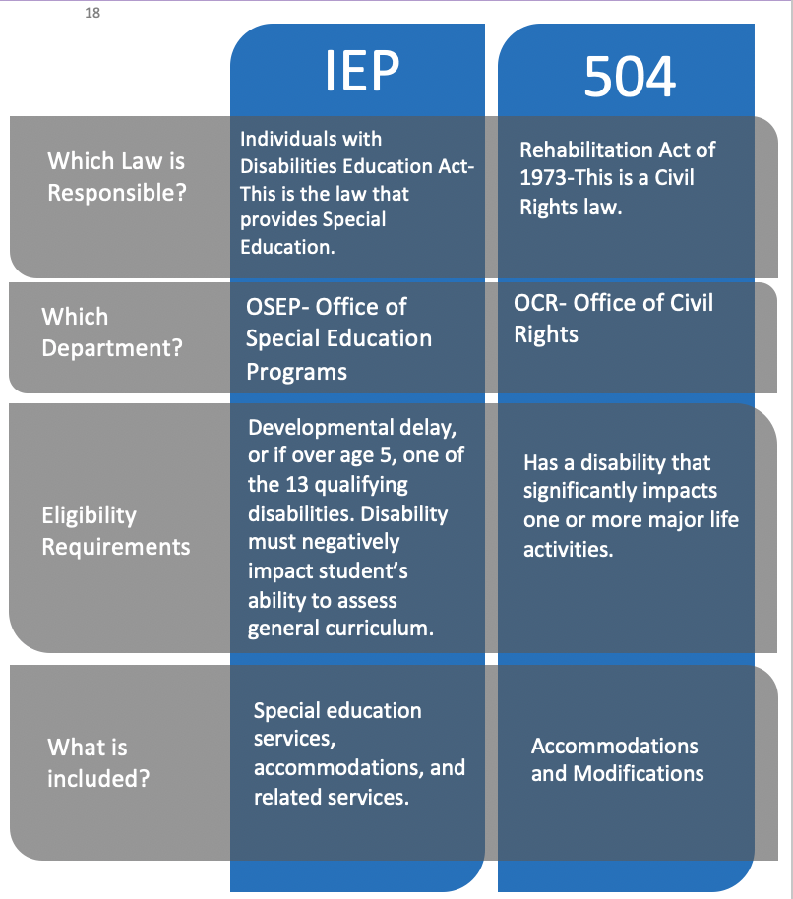
Notes:
Dylan:

Slide 34
504 Plans
Section 504 of the Rehabilitation Act allows for the provision of these plans based on civil rights law
… a disability should not inhibit a person from receiving FAPE
504 Plans allow for changes to the environment that will remove barriers for a student to access their education.
Notes:
Dylan: Unlike SDI where the curriculum is modified, a 504 does not alter the curriculum itself but rather changes the method by which it is delivered/received to give the student full access to it.
It prevents discrimination

Slide 35
504 Plans
Extra time to complete assignments or take tests
Specified Seating
They do NOT provide specially designed instruction by adjusting the curriculum or content of lessons
Help with organizing/managing timelines for assignments
Assistive Technology
Notes:
Dylan: *The only therapy that a student who has a 504 is entitled to is Occupational Therapy. This can be used to help with executive function tasks and organization.

Slide 36
504 Plans
There is no standard form or document for 504 plans.
Each school has the ability to devise their own plans
Each school will have a 504 coordinator
Schools are not required to invite parents to participate in developing the plan or making small changes to it
Schools DO have to notify parents if they are performing evaluations or identifying new diagnoses.
Notes:
Dylan A FAPE provided by IDEA is completed when an individual graduates or ages out (Now age 22).

Slide 37
504 Plans
504 Plans are NOT a part of IDEA. An IEP ends at graduation or the age of 22 because FAPE has been met.
504 Plan accommodations and modifications can follow an individual through life. Ex. College and employment environments
Notes:
Dylan: 504 Plans do not provide specially designed instruction. Refer to chart on pg 17 of booklet

Slide 38
Procedural Safeguards
The school is required by IDEA to provide notice of procedural safeguards to parents of students who have disabilities
This document outlines parents’ rights in working with the school
It does not address the structure of the IEP/504 plan, but rather it sets the rules for proper procedures
Notes:
Dylan: There are the protections for the parent and student
It provides an outline for managing disagreements

Slide 39

When a Dispute Occurs
There are times when parents and school district
staff do not agree on issues regarding;
evaluations
eligibility
services and placement of students
If a disagreement occurs, and the IEP team process is ineffective at developing an IEP acceptable to both the parents and school district, there are ways to address these as outlined in the Procedural Safeguards.
Notes:
Allison

Slide 40
IEP Facilitation
IEP facilitation is an optional process for using a neutral third party (facilitator) to promote communication and assist the IEP team in developing a mutually acceptable IEP.
Both parent and school district have to agree to participate
A facilitated IEP meeting is the same as any other IEP meeting, except that a facilitator joins the meeting
Facilitation cannot interfere with procedural safeguards, including a parent or district right to request a stand-alone mediation, state complaint investigation or due process hearing.
FIEPFacilitationHandbook.pdf (maine.gov)
Notes:
Allison

Slide 41
Addressing Disputes
Filing a complaint with DOE, investigator is assigned.
Mediation, if agreement is reached it is legally binding
Due process hearing, actual court hearing, there is an appeal process
Notes:
Dylan
These can occur separately or at the same time

Slide 42
Addressing Disputes Using
Procedural Safeguards and Due Process
1. Filing a complaint with the state
This may be filed by either a parent or organization and alleges that there was a violation of IDEA within in the school.
A Complaint Investigator is assigned and he/she examines the proposed violation.
There is no appeal process for the complaint, but if either party is unhappy with the outcome, they may proceed with mediation and/or due process.
Notes:
Dylan

Slide 43
Addressing Disputes Using
Procedural Safeguards and Due Process
2. Mediation is another process of resolving a conflict by which both parties (parents and school) agree to participate.
A mediator is assigned, and both the parents and school present their perspectives to them, as well as participate in discussions about ways to resolve their opposing viewpoints.
There is no appeal process for mediation, and the agreement is considered to be legally binding.
If an agreement cannot be met parents can move forward with Due Process.
Notes:
Dylan: Think of a mediator as an impartial 3rd party who can independently hear both sides of the story and help everyone reach a common ground solution.

Slide 44
Addressing Disputes Using
Procedural Safeguards and Due Process
3. A due process hearing is the last method by which a dispute may be resolved
A written complaint requesting due process may be filed to the Maine DOE by either the parent or the school district.
If both parties do not choose to resolve the dispute by participating in mediation, a resolution meeting is required.
There will be a hearing officer assigned to the meeting, and he/she is tasked with the responsibility of determining if a violation has occurred and how the violation must be remedied. Both parties provide evidence and/or witnesses.
There is an appeal process if the finding is not acceptable to the parties involved.
Notes:
Dylan:
Should be the very last method as it can be damaging to the relationship. Can be a long and costly avenue.
Always best to try to resolve issues prior to this to maintain the relationship

Slide 45

Family Support Navigators
Our Family Support Navigators are trained parents who have personal experience navigating the systems of care in Maine and can provide support at no-cost to you!
Notes:
Dylan and Allison

Slide 46





www.mpf.org
484 Maine Ave. 2D
Farmingdale, ME 04344
parentconnect@mpf.org
1-800-870-7746 (in-state only)
207-588-1933 (nationwide)
Notes:
Dylan and Allison

