Slide 1

ECE Consultation for ME: Maine’s Statewide Infant & Early Childhood Mental Health Consultation Program Rooted in Early Relationships ~ Growing Together
Melanie Miller, LCPC, LADC, CCS
DHHS, OCFS, ECE Division
ECE Consultation For ME Program Manager September 2, 2025

Slide 2
Learning Objectives:
Explain
Explain ECE Consultation for ME’s purpose, scope, and key service components, including supports for early care and education providers and families.
Understand
Understand how ECE Consultation for ME aligns with Maine’s early childhood strategic goals, promoting resilience, inclusion, and mental health in early care settings.
Identify
Identify opportunities for collaboration and referral, ensuring that families and early care professionals can access services early to address social, emotional, and behavioral concerns before they escalate.

Slide 3

Who We Are:
ECE Consultation for ME Is Maine’s
Infant & Early Childhood
Mental Health Consultation Program
We have up to 16 IECMH Consultants across the state providing direct support to early care and education providers, families, and community organizations.
At the state level, we are supported by 4 program staff within the Office of Child and Family Services.

Slide 4
Purpose & Scope
Statewide consultation program supporting children birth–8.
We partner with families, early educators, FCCPs, schools, and community teams.
Mission: strengthen the adults and environments that shape children’s development.
Approach: relationship-based, culturally responsive, trauma-informed.
Consultation supports adults and systems; it is not therapy for children.

Slide 5
Who We Serve:
ECE Consultation for ME provides consultation services to programs serving children from birth through age eight across Maine.
Licensed early child care providers
Family child care programs
Head Start classrooms
Public Pre-K programs,
Elementary schools

Slide 6
Poll: Who’s in the Room?
What is your role?
Options:
• Parent
• Family Child Care Provider
• Teacher/Educator
• Program Leader/Director
• School/District Partner
• Medical/Mental Health Partner
• Consultant
• Other

Slide 7
Poll: Who’s in the Room?
Where are you located?
Options:
Androscoggin
Aroostook
Cumberland
Franklin
Hancock
Kennebec
Knox
Lincoln
Oxford
Penobscot
Piscataquis
Sagadahoc
Somerset
Waldo
Washington
York

Slide 8
Transition: ECCP → ECE Consultation for ME
Transition
Why transition: align services to Maine’s needs, settings, and geography.
Keep
Keep the core IECMHC framework; tailor delivery, tools, and workflows.
Flexibility
Flexibility and expanded support for what Maine needs and can use now.
Strengthen
Strengthen statewide alignment with schools, Head Start, EI, and community partners.

Slide 9
Why IECMHC Matters:
Infant and Early Childhood Mental Health Consultation (IECMHC):
Focuses on building the skills and capacity of the adults
who care for and educate young children
Strengths-based, relationship-driven, and preventive.
Reduces stress for providers, increases family
engagement, and improves child outcomes.
National studies show IECMHC:
Reduces suspensions/expulsions
Improves classroom climate
Supports inclusive practices.

Slide 10
How Consultation Works
Indirect model: Consultants do not provide therapy to children. They build adult capacity.
Collaborative partnership: Consultant and provider/family co-develop goals, test strategies, and reflect.
Observation: Consultants observe routines, transitions, and environments to interpret behaviors.
Reflection: Providers and families engage in reflective practice to build insight and strategies.
Capacity building: Skills remain with adults after consultation, ensuring long-term sustainability.

Slide 11
Why Consultation Works:
Strengths-based: Builds on what providers and families are already doing well.
Relationship-driven: Children thrive in safe, nurturing relationships; consultation strengthens those bonds.
Evidence-informed: Studies show IECMHC improves teacher-child relationships, reduces teacher stress, decreases classroom removals, and improves child self-regulation.
Flexible: Works across Maine’s mixed-delivery system: FCCPs, centers, schools, Head Start.
Culturally responsive: Tailors strategies to the family and community context.

Slide 12
Consultation Benefits Many
Educators: Gain practical classroom strategies, reduced stress, increased satisfaction, and more inclusive practices.
Parents & Families: Receive reassurance, guidance, practical home strategies, and stronger communication with providers.
Children: Promotes emotional wellbeing & resilience, Builds social skills & readiness to learn, Reduces risk of exclusion or expulsion
Administrators & Policymakers: Cost-effective, evidence-based prevention aligned with state goals, supports workforce stability and equity, and provides data for improvement.
Doctors & Health Professionals: IECMHC reduces unnecessary referrals, integrates mental health with child health, and provides families with practical strategies.
Case Managers & Social Workers: IECMHC is a preventive support that reduces crises, strengthens routines, and connects families to resources.

Slide 13
What IECMH Consultants Do
Work
Work side-by-side with educators, caregivers, and families to co-create practical strategies.
Provide
Provide tools and resources that strengthen relationships, routines, and emotional support in early learning settings.
Help
Help staff reflect on their practice and build confidence in addressing challenging behaviors.
Connect
Connect families and providers with community resources when additional support is needed.
Promote
Promote long-term resilience by embedding practices that prevent problems before they start.

Slide 14

ECE Consultation for ME
IECMHC Service Level Focus

Slide 15
IECMHC Service Focus
Child-Level
Emotional Regulation
Social Skills & Peer Interaction
Attachment & Relationships
Behavioral Self-Control
Developmental Progress
Trauma-Informed Focus

Slide 16
IECMHC Service Focus
Provider-Level
Knowledge of Social-Emotional Development
Use of Reflective Practice
Behavior Guidance & Positive Supports
Provider Confidence & Efficacy
Trauma-Informed & Culturally Responsive
Practice
Relationship Building with Families

Slide 17
IECMHC Service Focus
Classroom/Program-Level
Classroom Climate & Environment
Group Social-Emotional Skill Building
Preventing Suspension & Expulsion
Equity, Inclusion & Anti-Bias Practice
Program-Wide Mental Health Promotion
Fidelity to Consultation Practices

Slide 18
IECMHC Service Focus
Family-Level
Parent-Child Relationship Strengthening
Caregiver Emotional Regulation & Stress
Reduction
Developmental & Behavioral Awareness
Family Engagement with Early Learning
Service Access & Navigation

Slide 19
IECMHC Service Focus
System-Level
Cross-System Integration
Workforce Development & Capacity Building
Data-Driven Decision-Making
Sustainability & Infrastructure
Policy & Advocacy

Slide 20
Training & Consultation Groups
Statewide PD training
Topic-specific sessions (e.g., trauma-responsive practices, challenging behaviors, self-care)
Role-based consultation groups
Collaboration and Connection

Slide 21
Summary: Service Levels at a Glance
Service Level | Focus & Key Supports
Child-Level | Strategies for individual children; plans created with teachers and families.
Classroom | Support for teachers and staff to improve routines, climate, and engagement.
Program/Center | Work with directors and leaders to improve policies, staff support, and culture.
FCCP | Tailored consultation for home-based providers, mixed-age groups, and routines.
Systems-Level | Coordinate across schools, agencies, and partners to align practices and transitions.
Training & Groups | Professional development, reflective groups, and skill-building sessions.

Slide 22
Program Flow
Request/Referral
Intake & Consent
Consultation Plan
Consultation Cycles
Review & Closure
Follow-up

Slide 23
What Consultation Is & Is Not
Consultation IS:
Consultation, modeling, problem-solving with adults.
Strategies for environments, routines, and relationships.
Connection to community resources.
Consultation IS NOT:
Child therapy, evaluation for special education, crisis-only service.
A compliance audit; we are partners and capacity builders.

Slide 24
Ethics & Boundaries
Free & Voluntary Service
Consultation ≠ Therapy
No Diagnosis or Treatment
Confidentiality & Mandated Reporting
Secure Communications Only
Aggregate Reporting – No PII Shared

Slide 25

When to Reach Out
You don’t have to wait until a problem feels “big” to seek support.
When things are going well:
Strengthen your successful routines and learning environment.
When you're concerned:
Get support around emotional, developmental, or behavior concerns.
When things feel difficult:
Gain strategies and guidance to manage stress, transitions, or challenges in your setting.

Slide 26
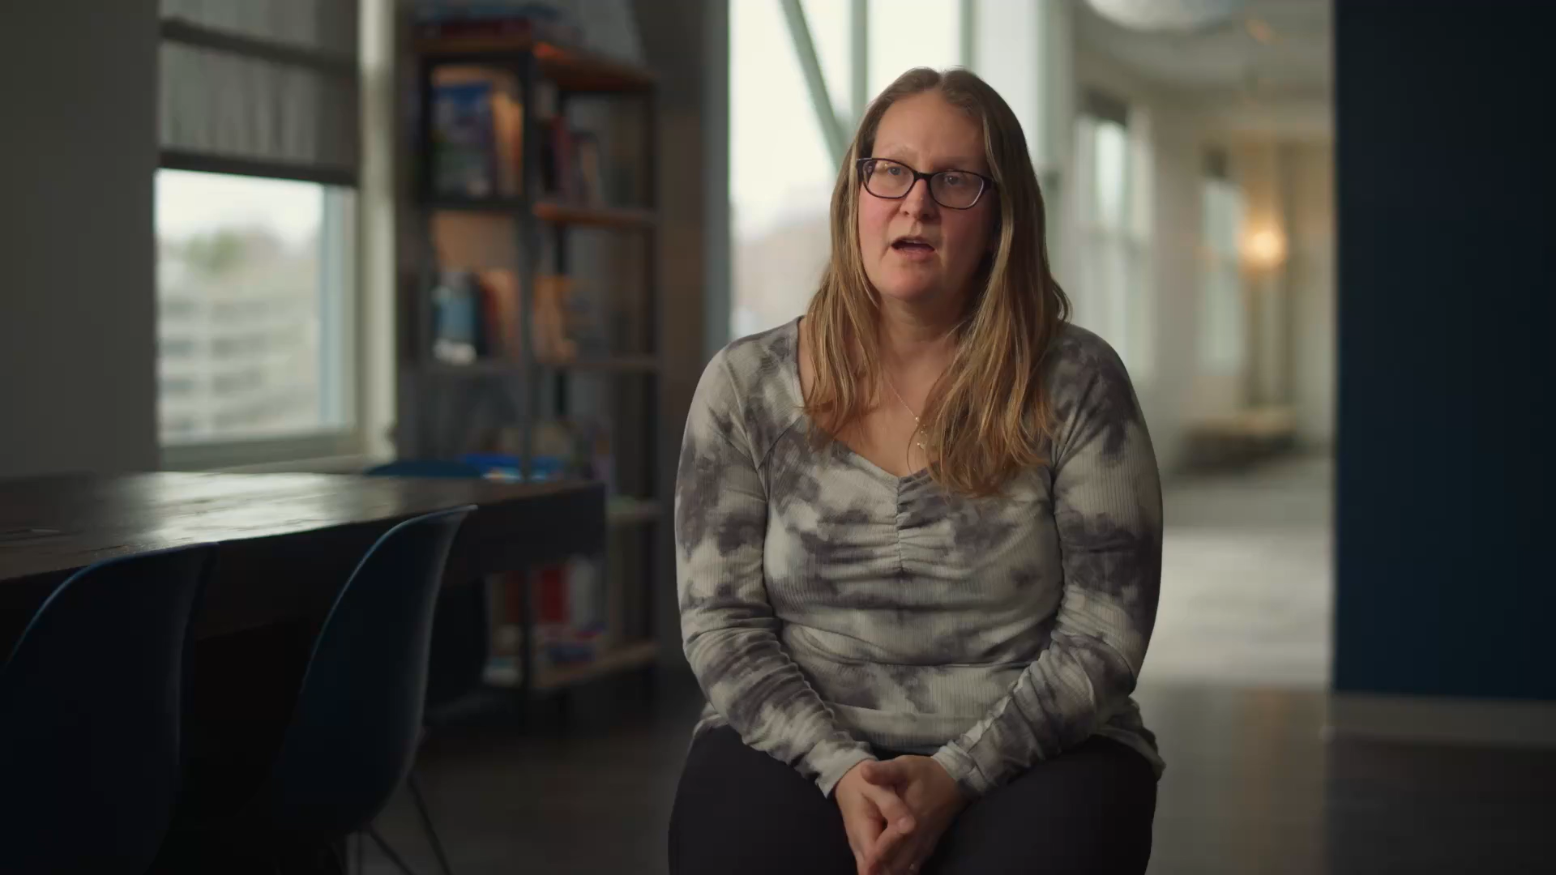
IECMHC Provider & Consultant Program Video
Insert Marketing Video Here

Slide 27
How to Refer (Simple Steps)
1) Contact the Consultant in your area or the ECE Consultation for ME Program
2) Provide information on reason for referral, choose the service level (child, classroom, program, FCCP, systems).
3) Obtain appropriate consents when child-focused.
4) Consultant schedules an intake call to set priorities.
5) Co-create a plan; begin consultation and progress check-ins.

Slide 28
Referral Pathways & Triage
Intake review aligns service level to need and urgency.
Child-safety concerns prioritized; coordinate with program leaders as needed.
Warm handoffs to community resources when beyond scope (e.g., therapy).
Set a review date for progress and next steps.

Slide 29
Q & A
Questions, reflections, and next steps.

Slide 30


Thank You & Program Contact
Melanie Miller, LCPC, LADC, CCS
ECE Consultation for ME
Program Manager
Office of Child & Family Services
2 Anthony Avenue
11 State House Station
Augusta, ME 04333
ECforME@maine.gov
Ph: (207) 624-7991
Toll free: 1-877-680-5866

